Slide 1
One-Point Perspective
Adding complexity to simple boxes

Slide 2
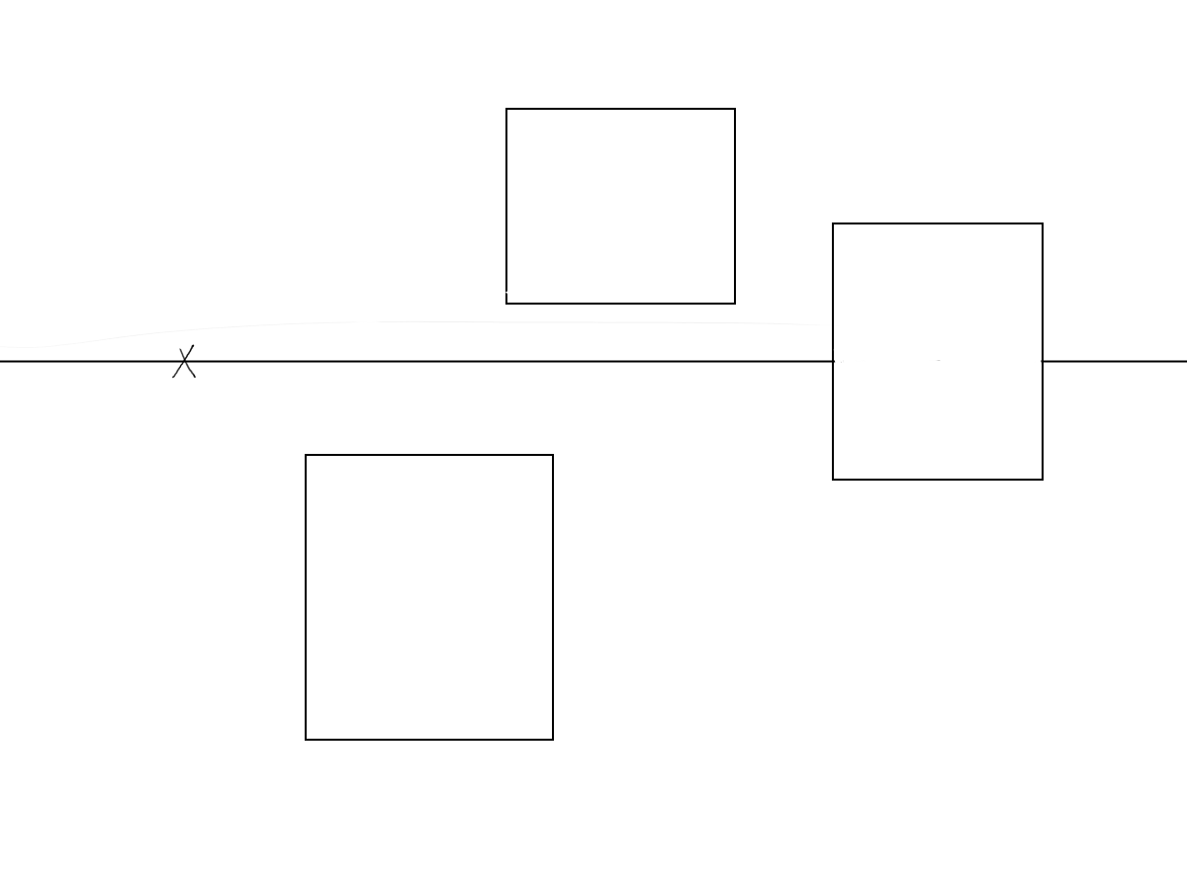
Draw:
A horizon line
A vanishing point
Three rectangles

Slide 3
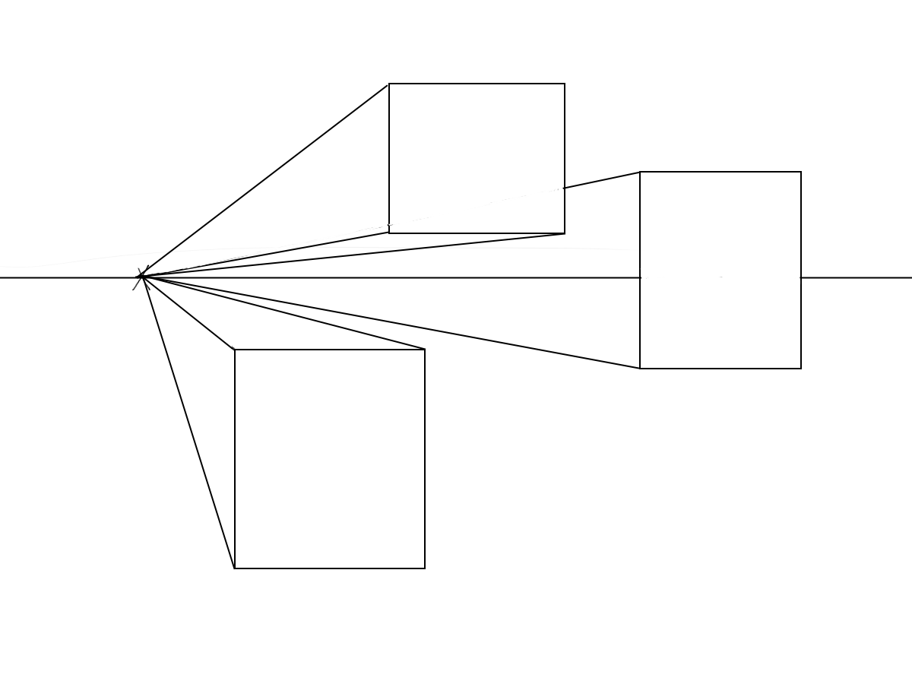
Draw:
Perspective lines that connect the corners of your rectangles to the center of the vanishing point. (You can ignore any perspective lines that cross through the rectangles.)

Slide 4
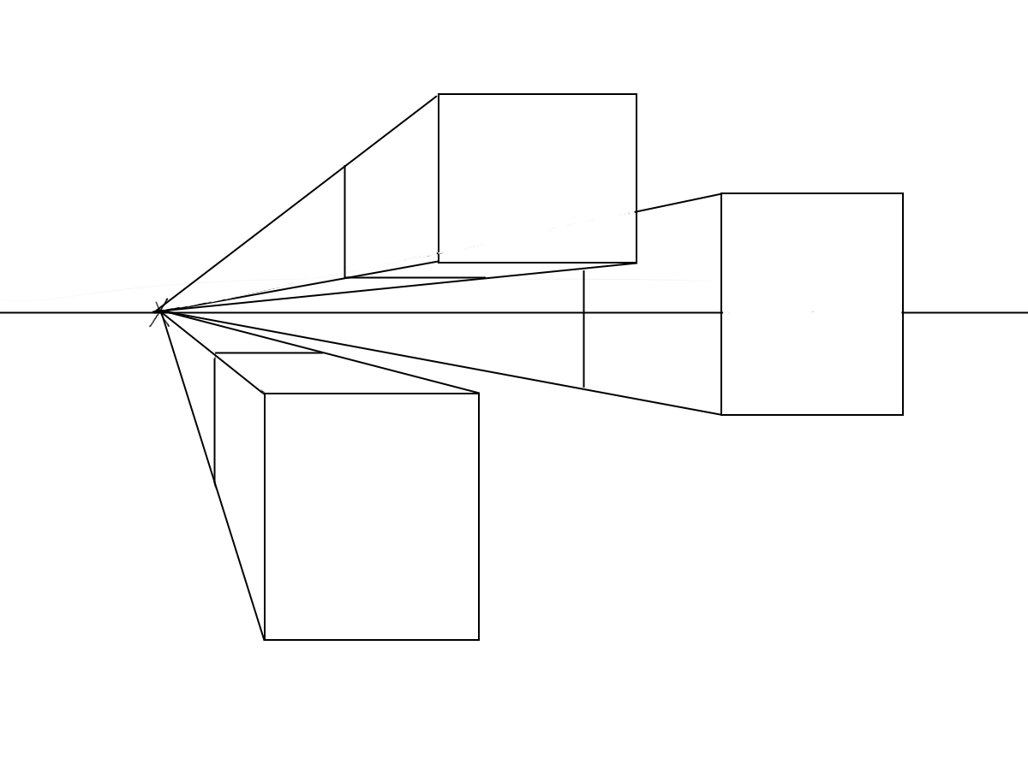
Draw:
Echo both the vertical and the horizontal lines of your rectangles to create rectangular prisms.

Slide 5
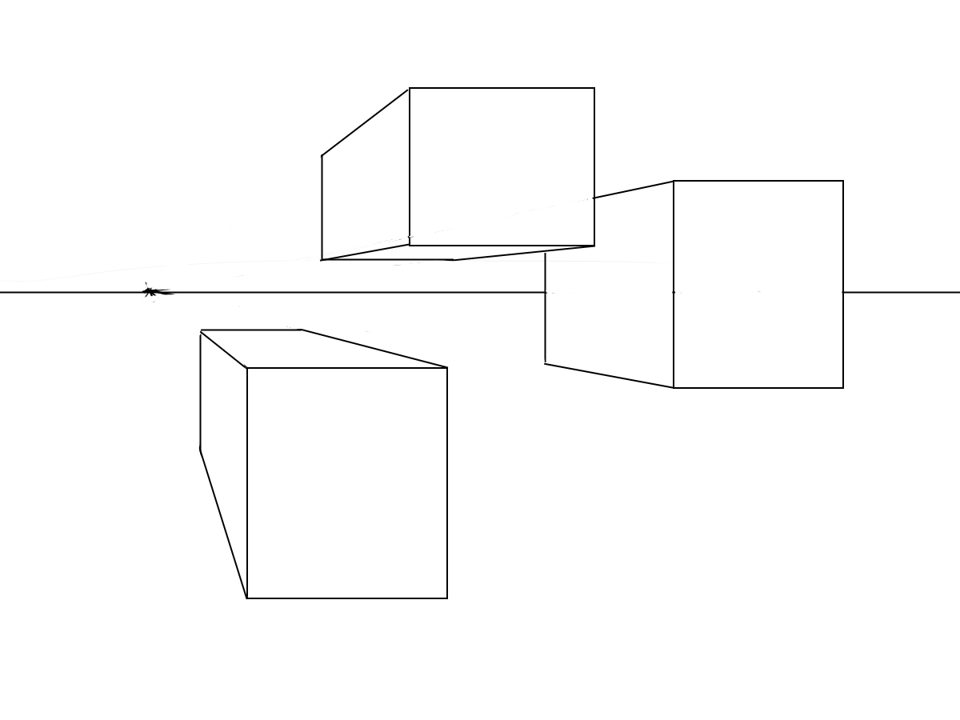
Draw:
Erase the perspective lines that are not part of your rectangular prisms.

Slide 6
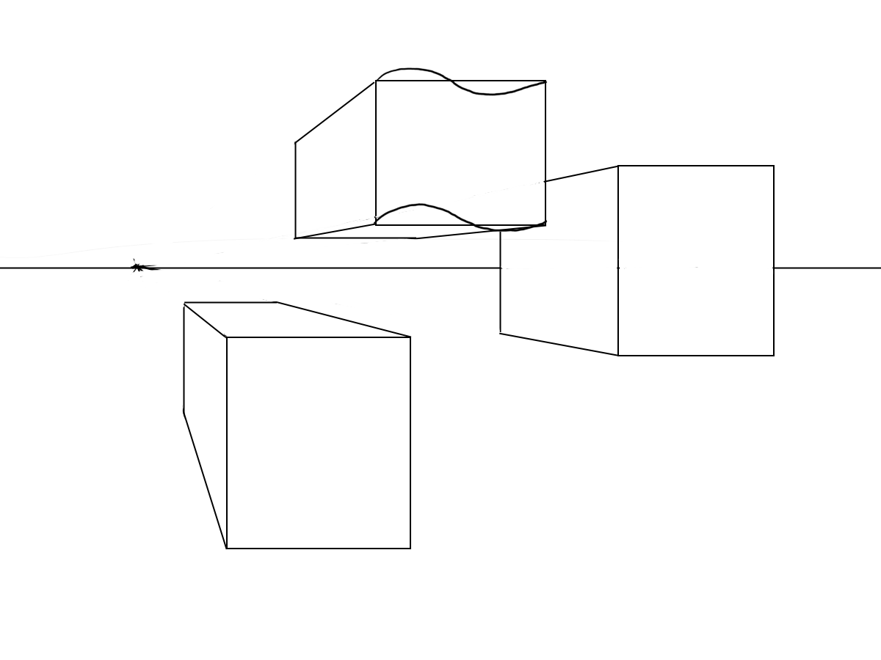
OPTION 1:
Alter the echoing lines of your rectangular prism.
Redraw the lines to have more complex shapes.

Slide 7
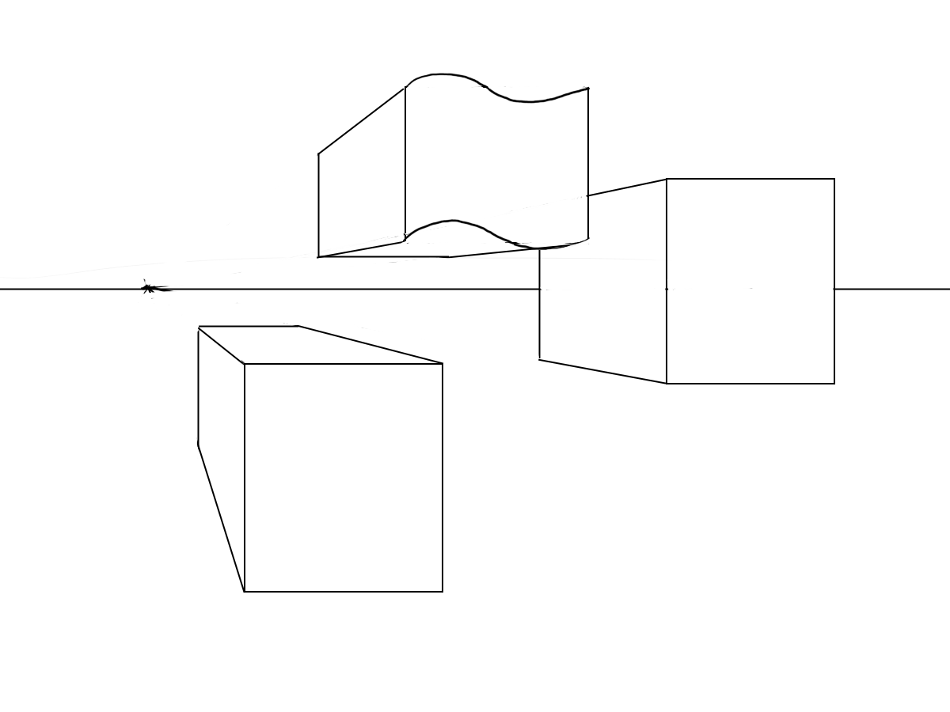
OPTION 1:
Alter the echoing lines of your rectangular prism.
Redraw the lines to have more complex shapes.
Erase old lines.

Slide 8
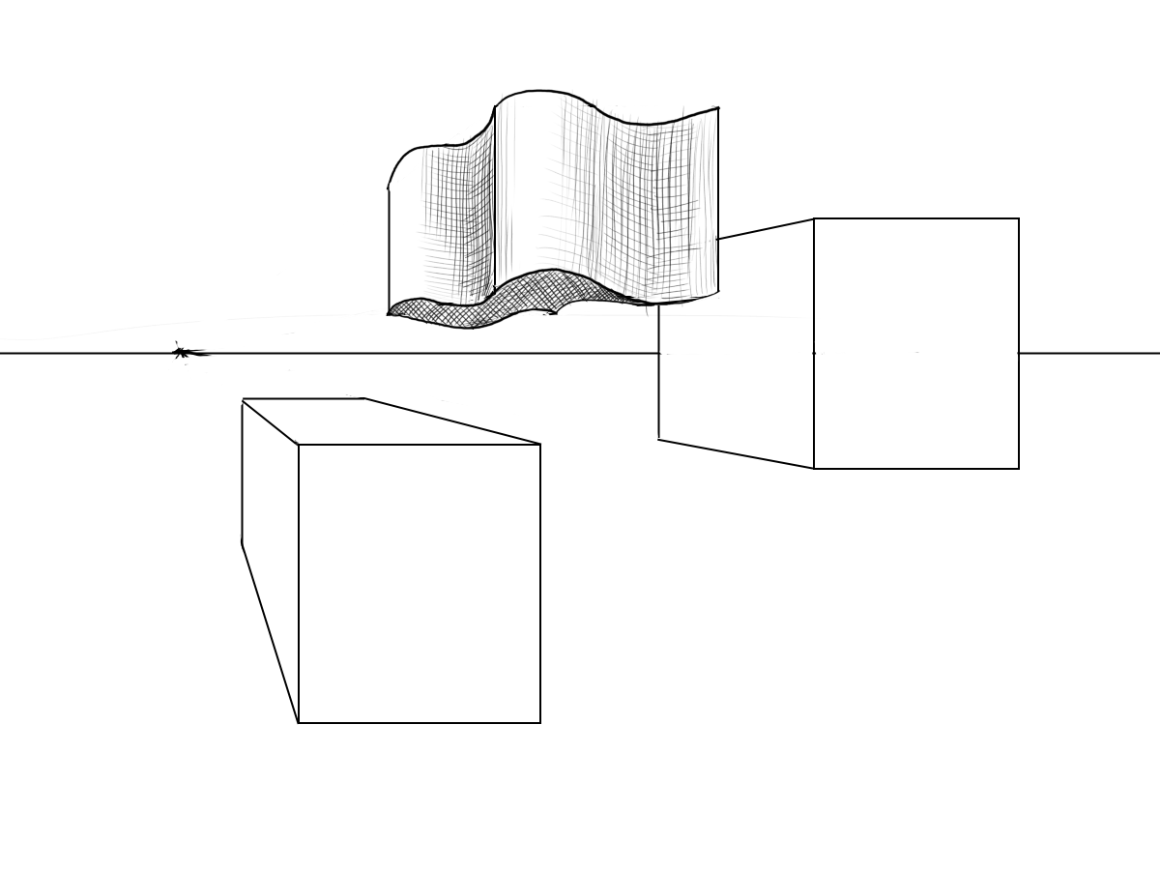
OPTION 1:
Alter the echoing lines of your rectangular prism.
Redraw the lines to have more complex shapes.
Erase old lines.
Continue adding details and shading to add interest to your former prism.

Slide 9
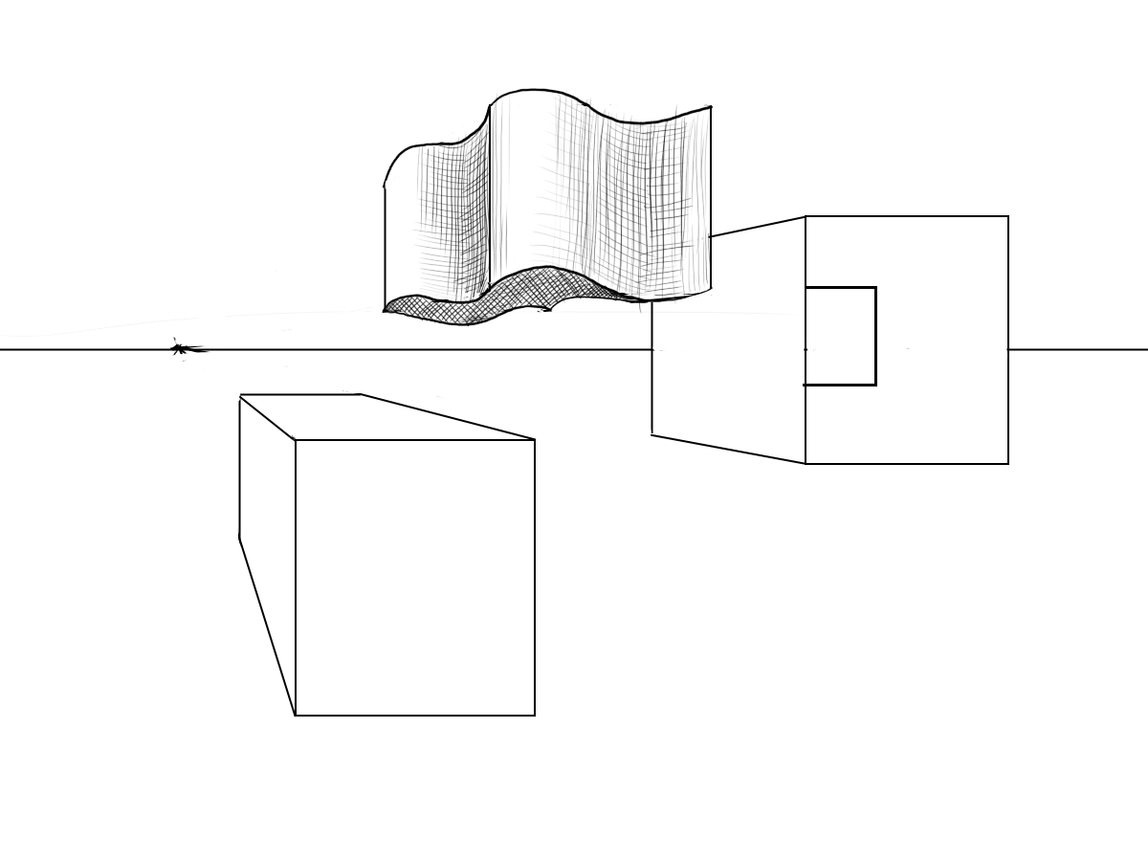
OPTION 2
Remove a section of your rectangular prism.
Use vertical and horizontal lines to “cut” out a section.

Slide 10
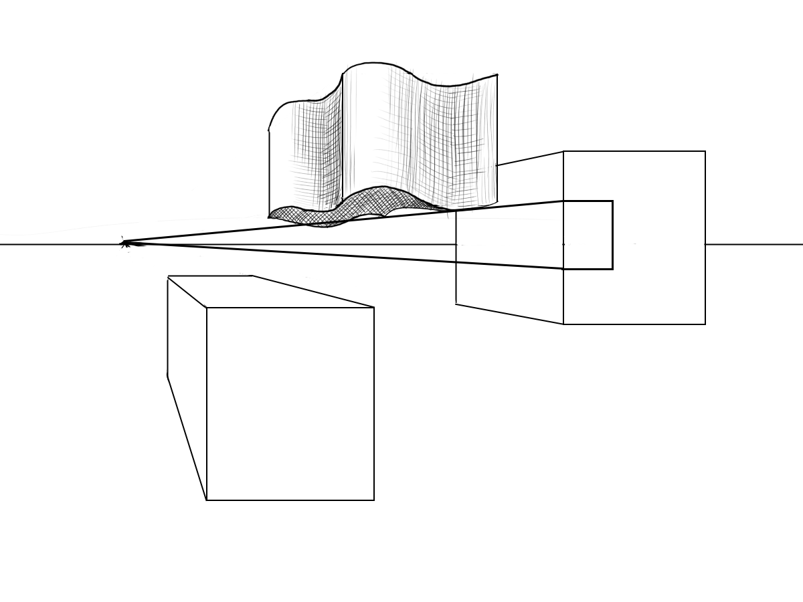
OPTION 2
Remove a section of your rectangular prism.
Use vertical and horizontal lines to “cut” out a section.
Use your Vanishing Point to create depth.

Slide 11

OPTION 2
Remove a section of your rectangular prism.
Use vertical and horizontal lines to “cut” out a section.
Use your Vanishing Point to create depth.
End the section and erase excess lines.

Slide 12
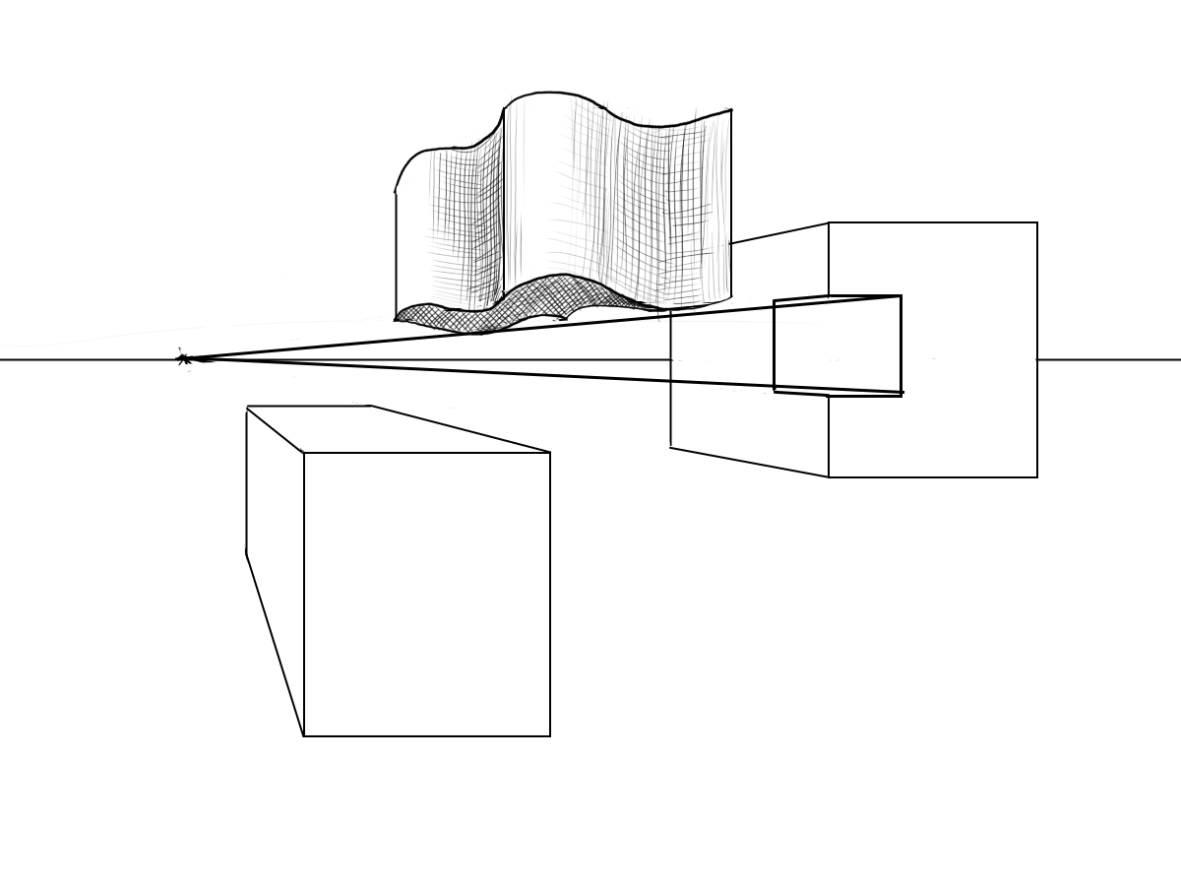
OPTION 2
Remove a section of your rectangular prism.
Use vertical and horizontal lines to “cut” out a section.
Use your Vanishing Point to create depth.
End the section and erase excess lines.

Slide 13
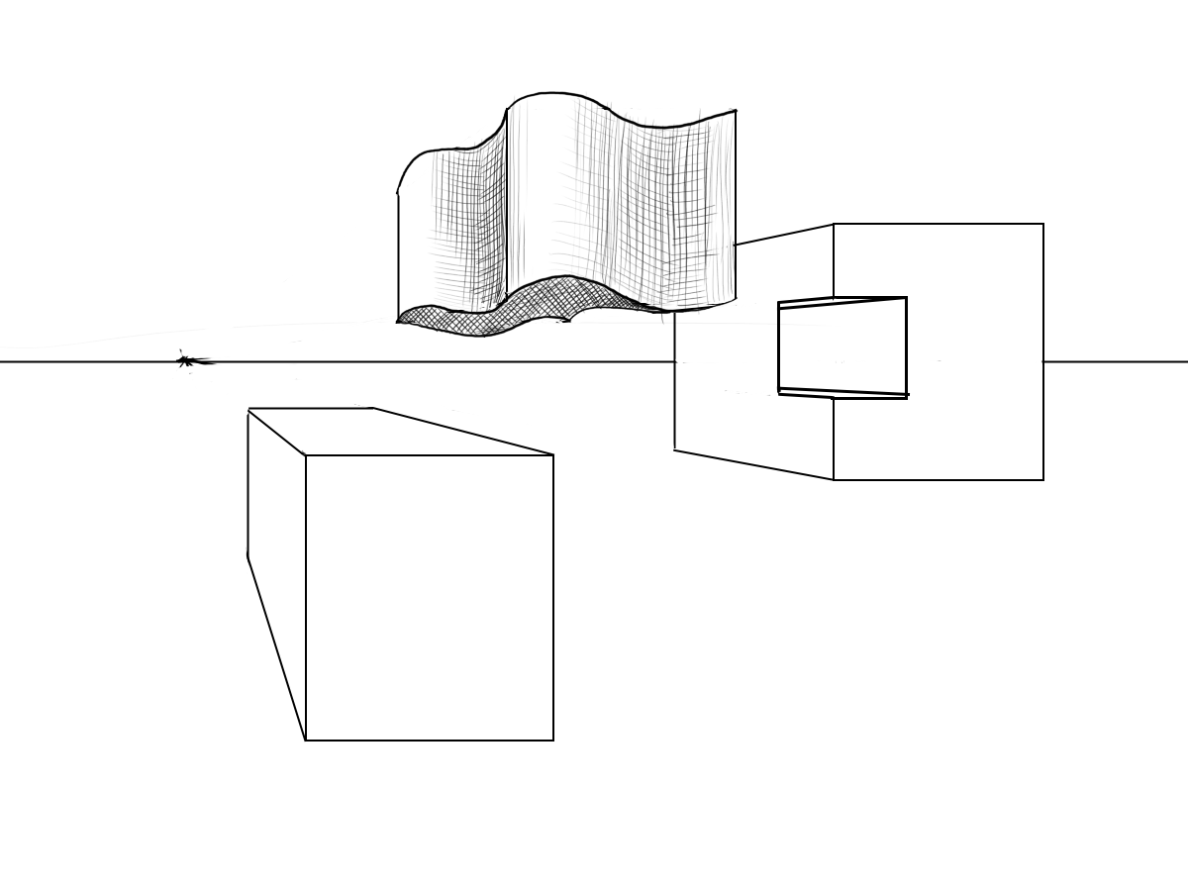
OPTION 2
Remove a section of your rectangular prism.
d) Use perspective to make the piece make sense to YOU. (There are many ways to do this).

Slide 14
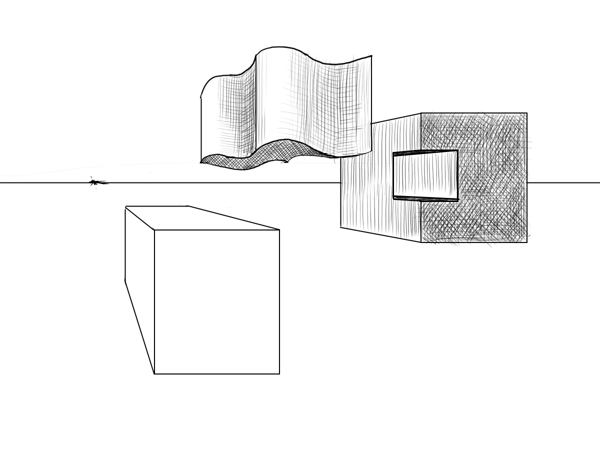
OPTION 2
Remove a section of your rectangular prism.
d) Use perspective to make the piece make sense to YOU. (There are many ways to do this).
e) Add shadow.

Slide 15
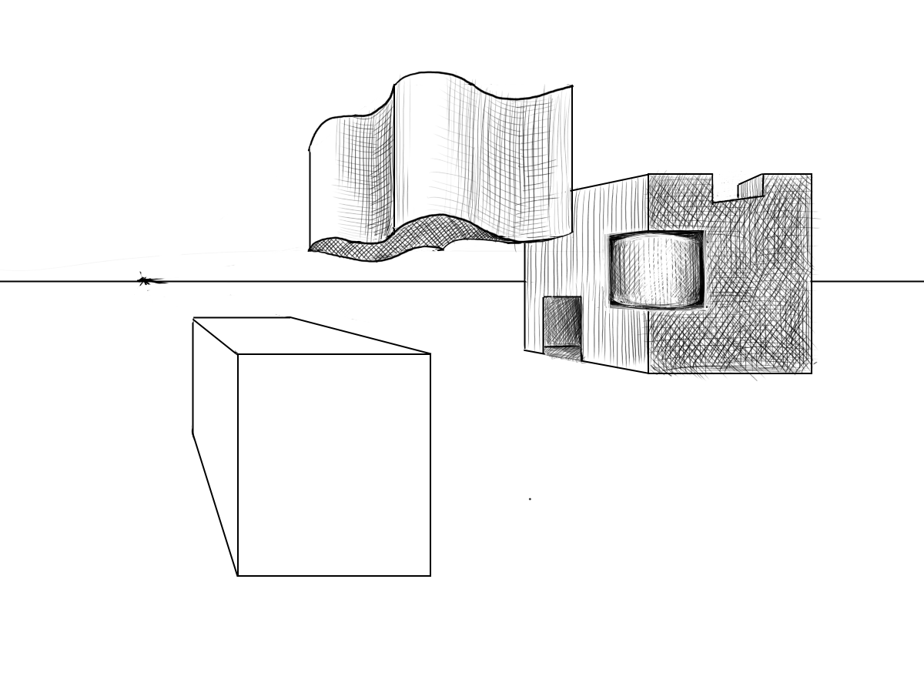
OPTION 2
Remove a section of your rectangular prism.
d) Use perspective to make the piece make sense to YOU. (There are many ways to do this).
e) Add shadow.
f) Keep playing with the piece until you like it!

Slide 16
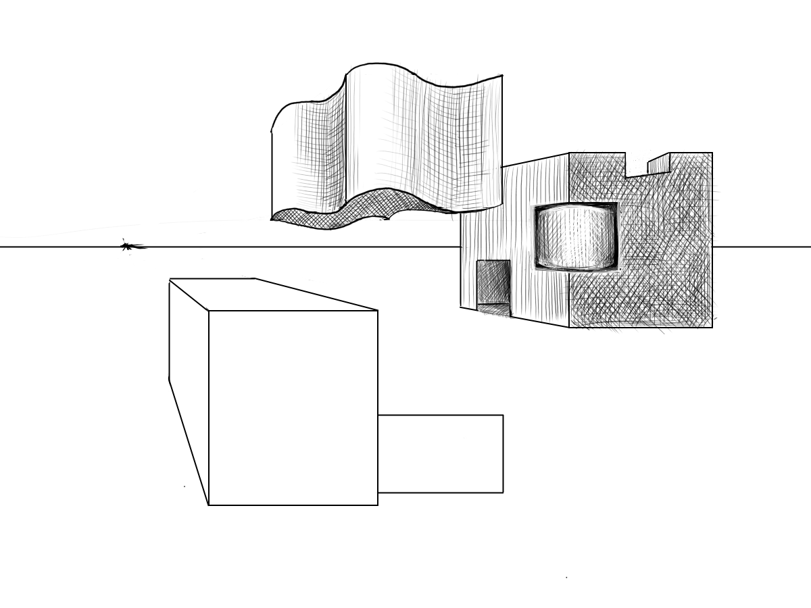
OPTION 3:
Add extra sections to your rectangular prisms.
Start with vertical and horizontal lines.

Slide 17
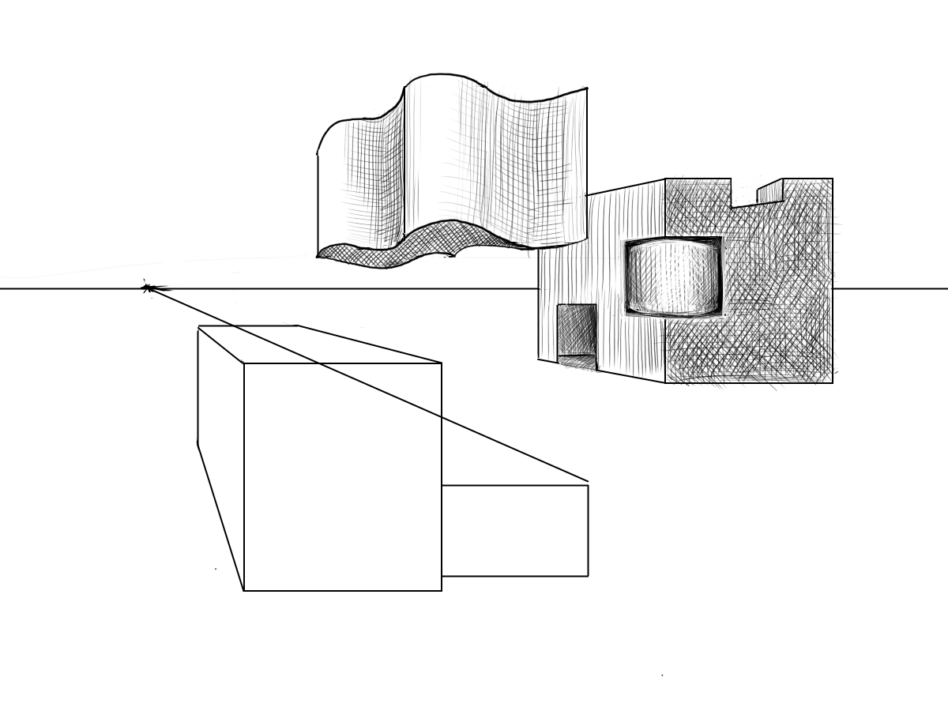
OPTION 3:
Add extra sections to your rectangular prisms.
Start with vertical and horizontal lines.
Use your VP to create depth.

Slide 18
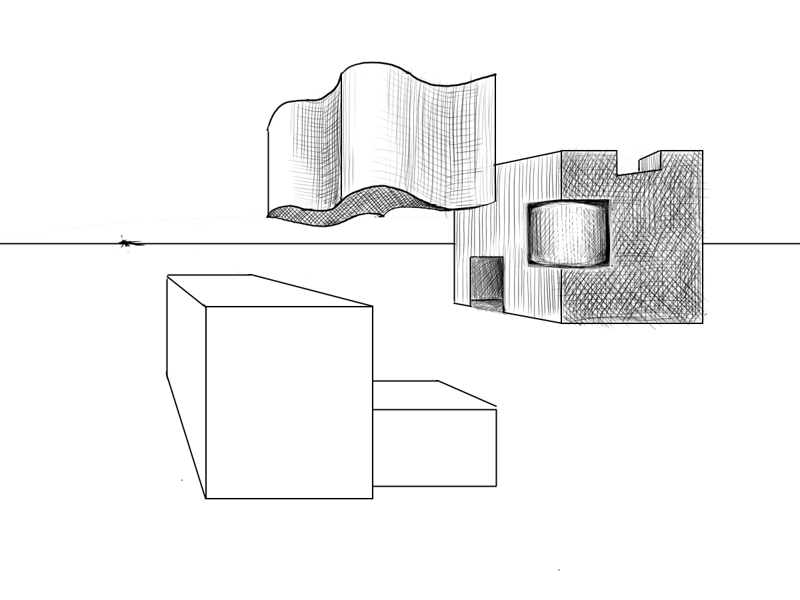
OPTION 3:
Add extra sections to your rectangular prisms.
Start with vertical and horizontal lines.
Use your VP to create depth.
Use echoing lines to complete your new forms.

Slide 19
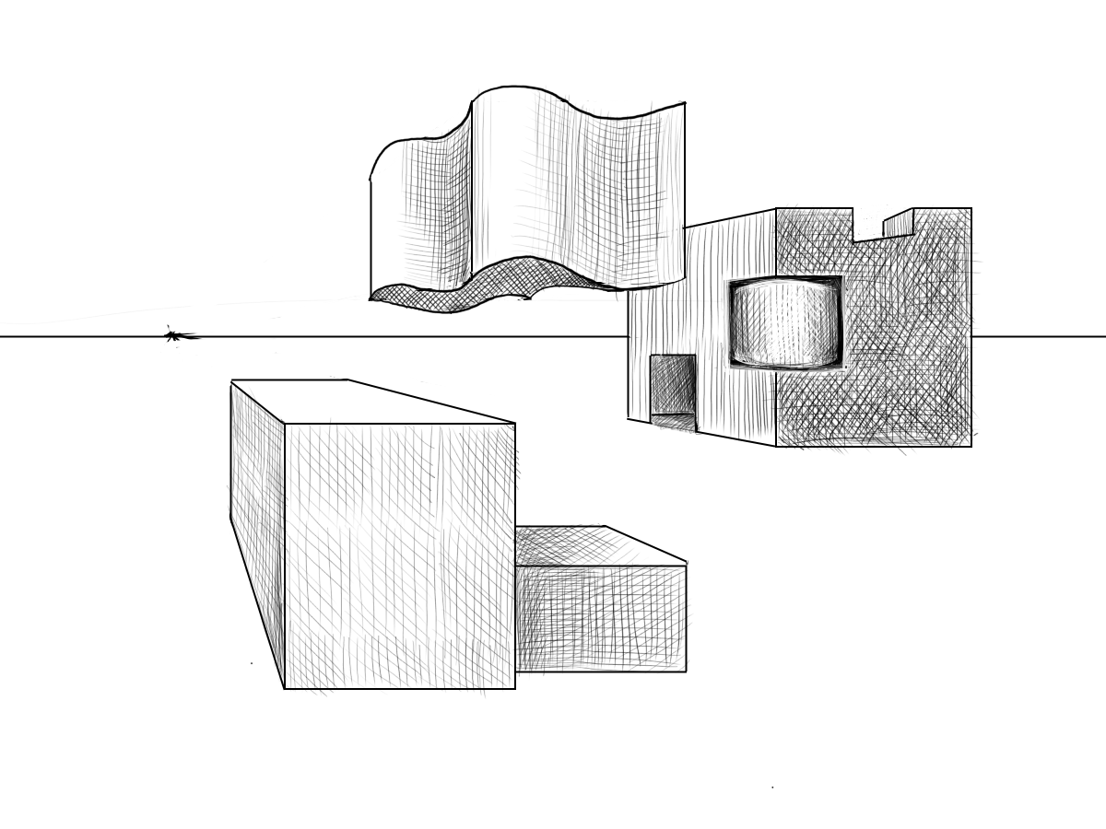
OPTION 3:
Add extra sections to your rectangular prisms.
Start with vertical and horizontal lines.
Use your VP to create depth.
Use echoing lines to complete your new forms.
Shade!

Slide 20
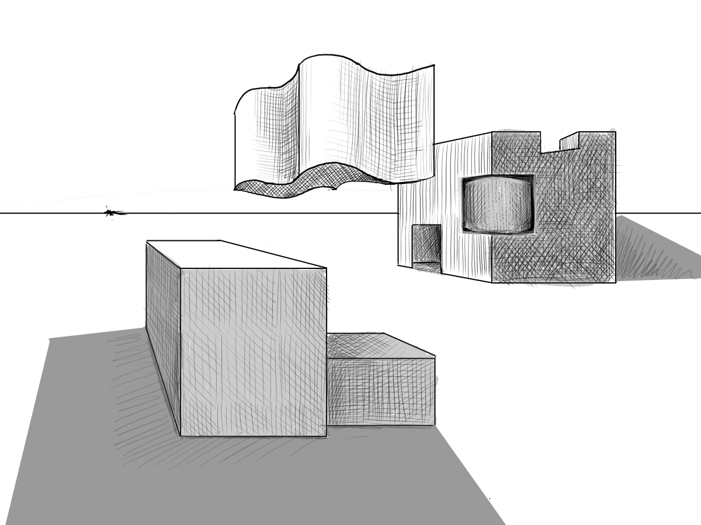
Add details that create Unity in the piece. Shading all the forms in a similar way will do this!

Slide 21
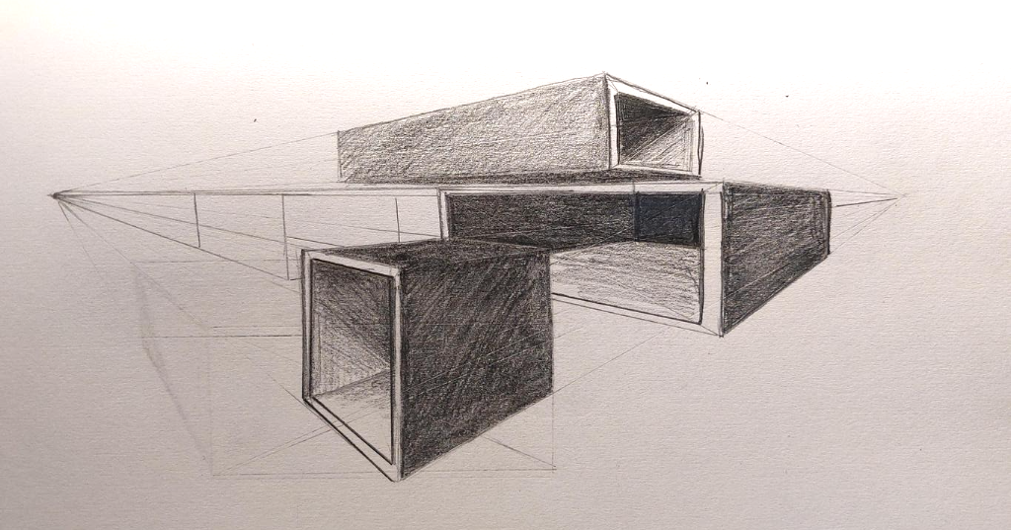
Preview for next week - Sample, Student Work using 2 Point Perspective

