Slide 1
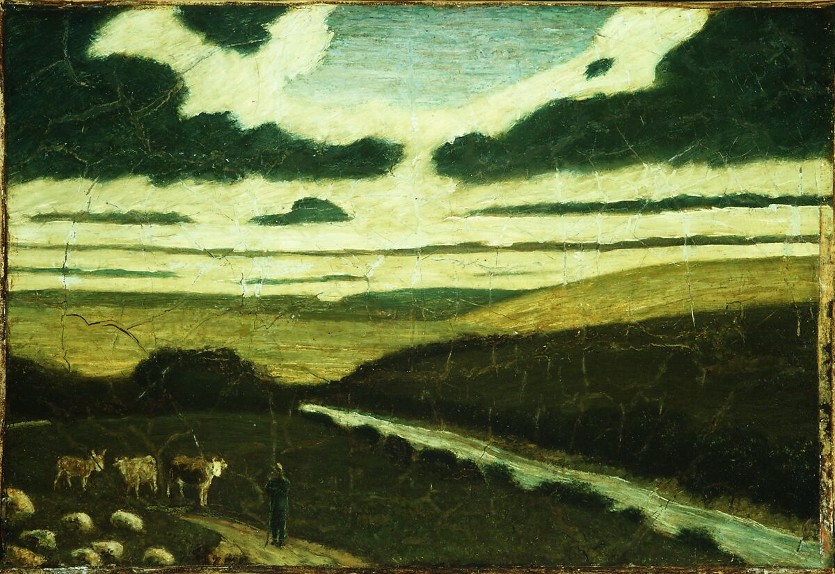
Capturing the Proportions of an Image with a Viewfinder
Landscape
Albert Pinkham Ryder American 1897–98
Notes:
https://www.metmuseum.org/art/collection/search/11978

Slide 2
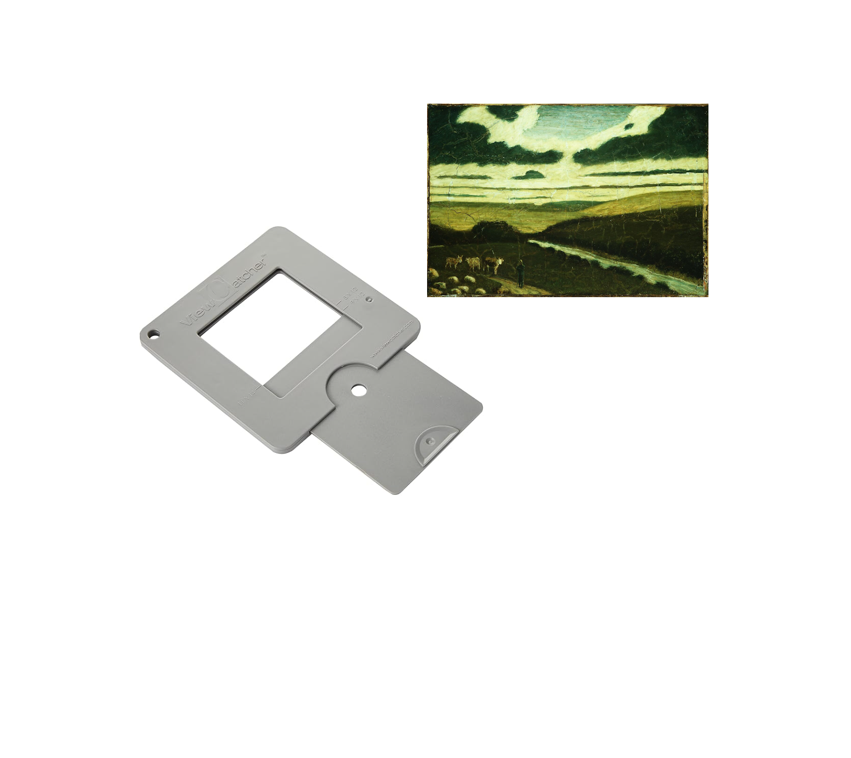
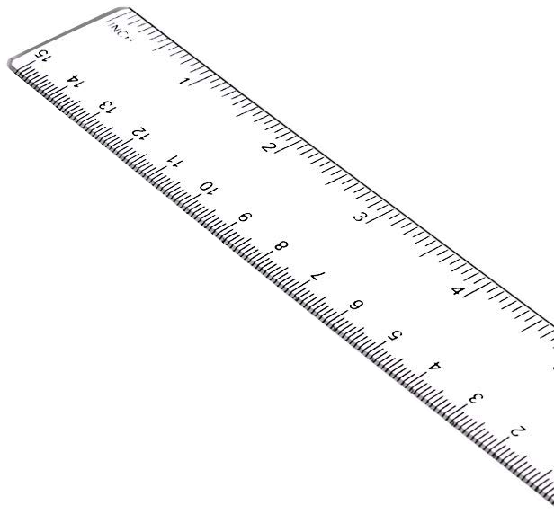
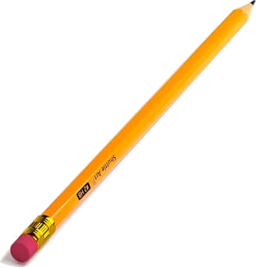
Materials Needed
Image
Viewfinder
Pencil
Ruler (optional)
Notes:
Landscape
Albert Pinkham Ryder American 1897–98
https://www.metmuseum.org/art/collection/search/11978

Slide 3
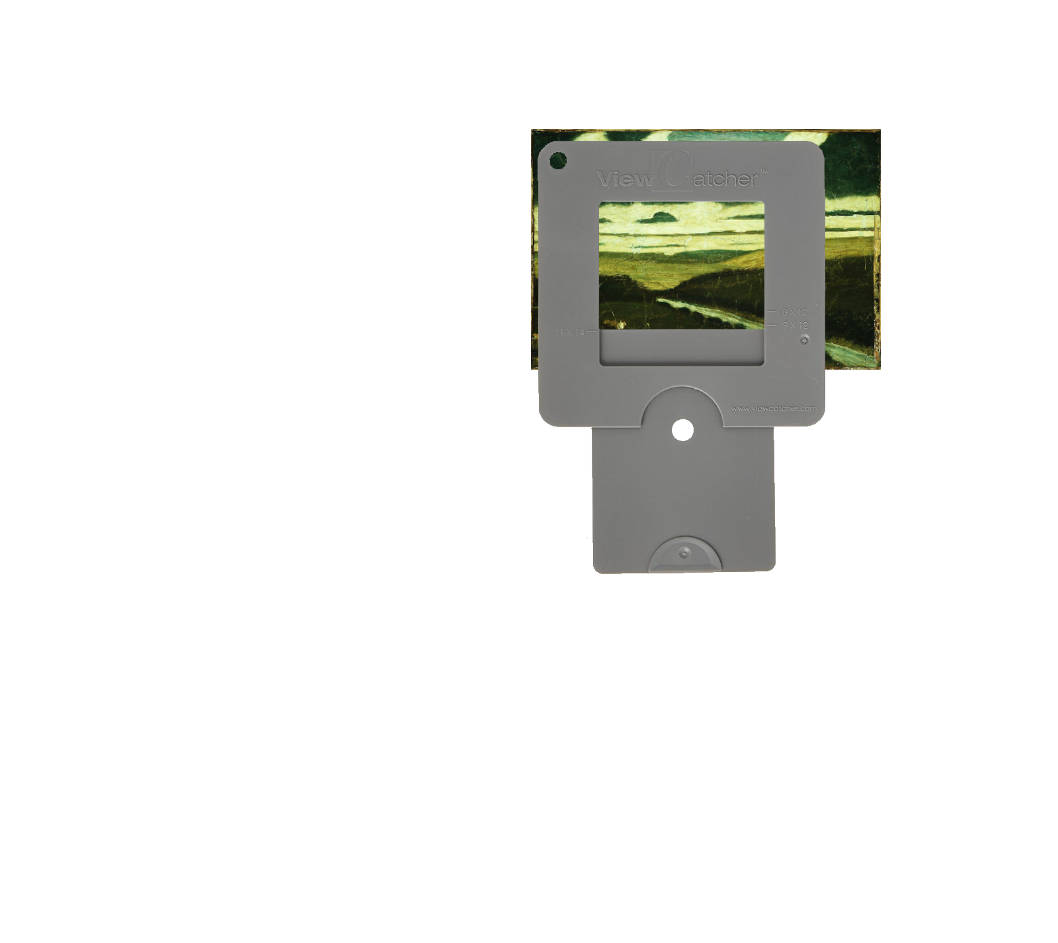
Align the viewfinder with the image.
Notes:
Landscape
Albert Pinkham Ryder American 1897–98
https://www.metmuseum.org/art/collection/search/11978

Slide 4
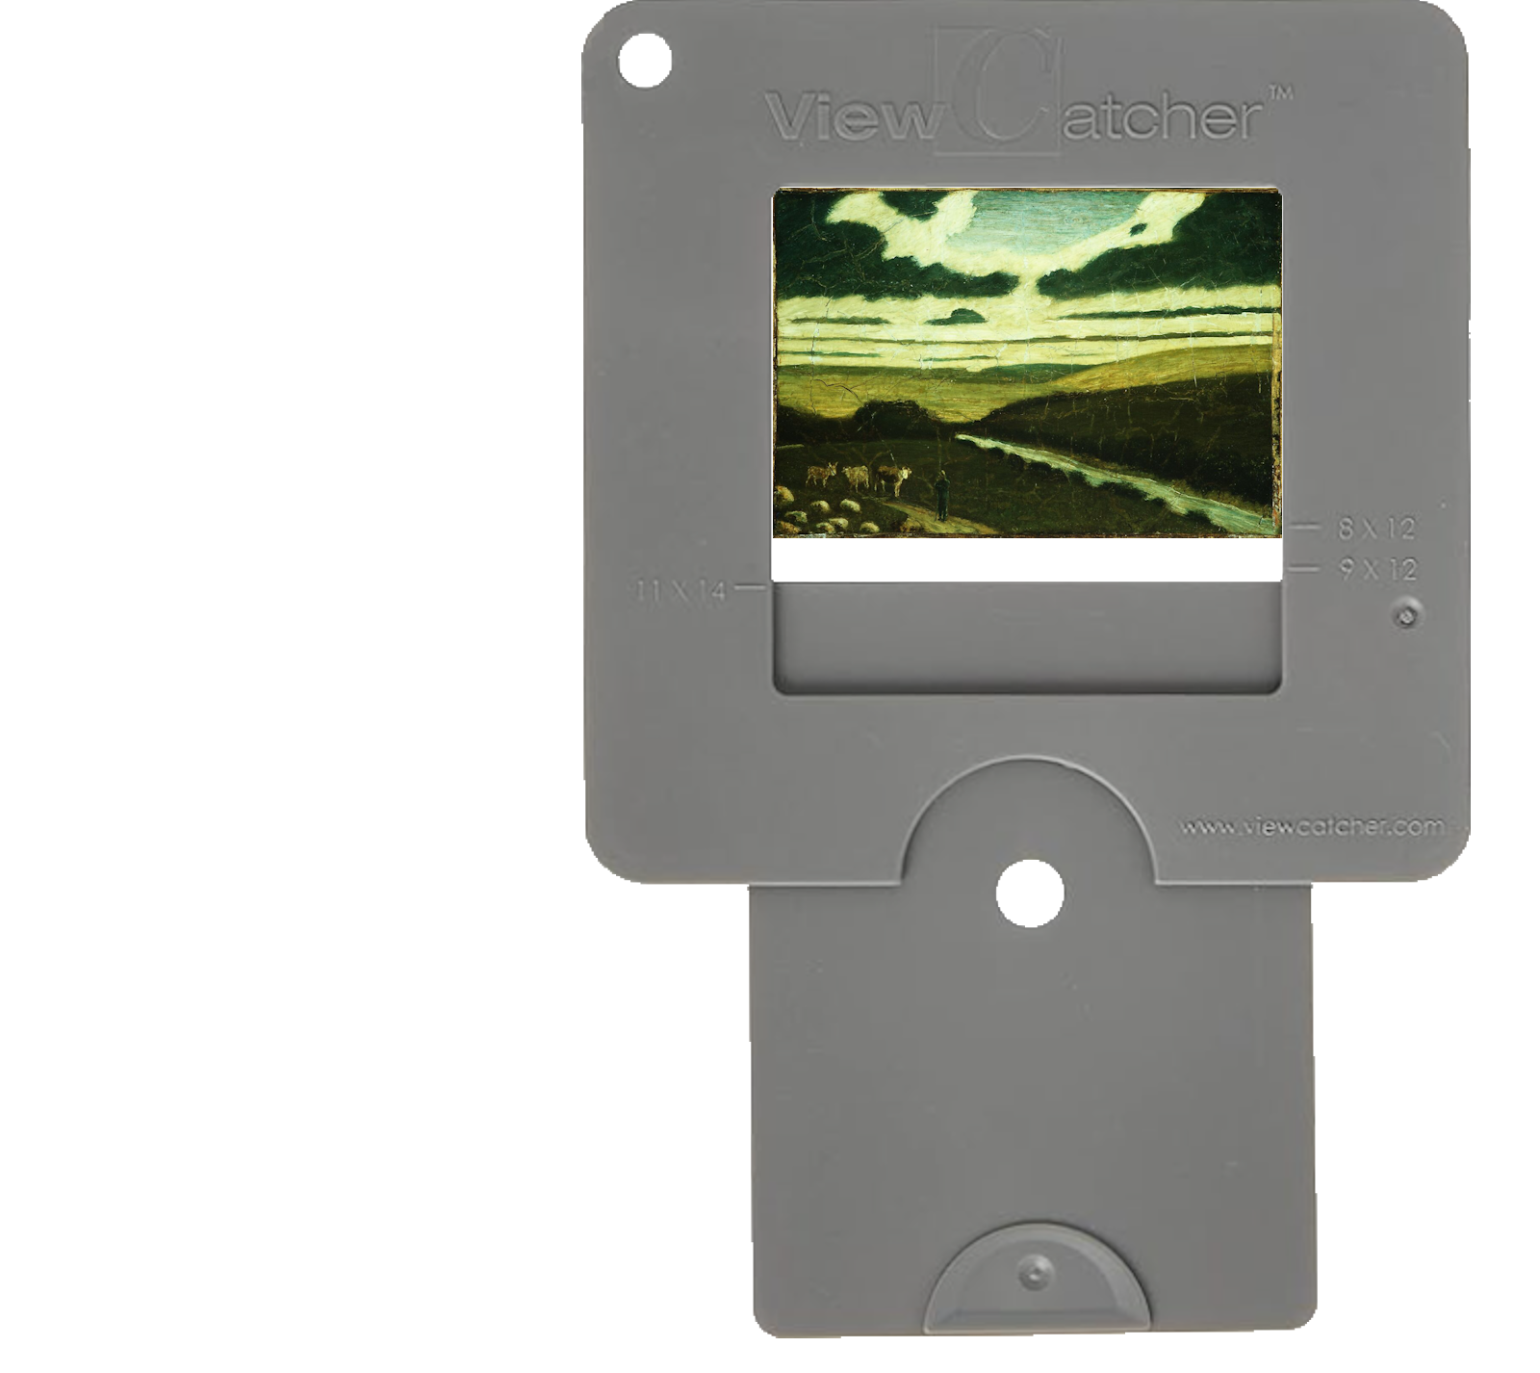
Match three sides of the viewfinder to the picture by adjusting the distance between the viewfinder and your eye.
Notes:
Landscape
Albert Pinkham Ryder American 1897–98
https://www.metmuseum.org/art/collection/search/11978

Slide 5
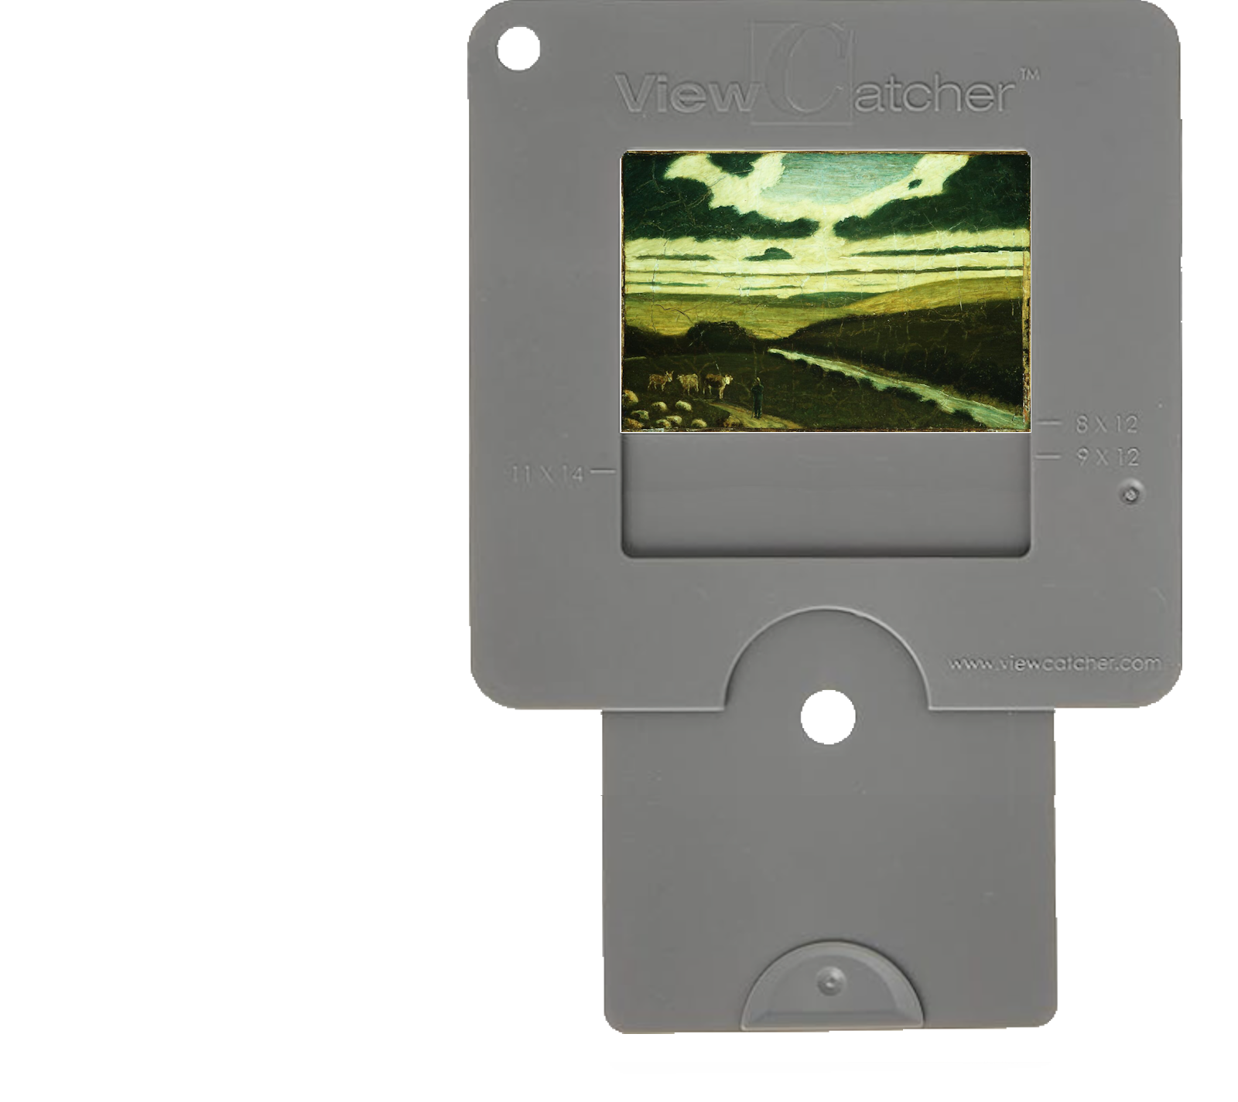
Slide the viewfinder window until it matches the fourth side.
Now the viewfinder has the same proportions as the image.
Notes:
Landscape
Albert Pinkham Ryder American 1897–98
https://www.metmuseum.org/art/collection/search/11978

Slide 6
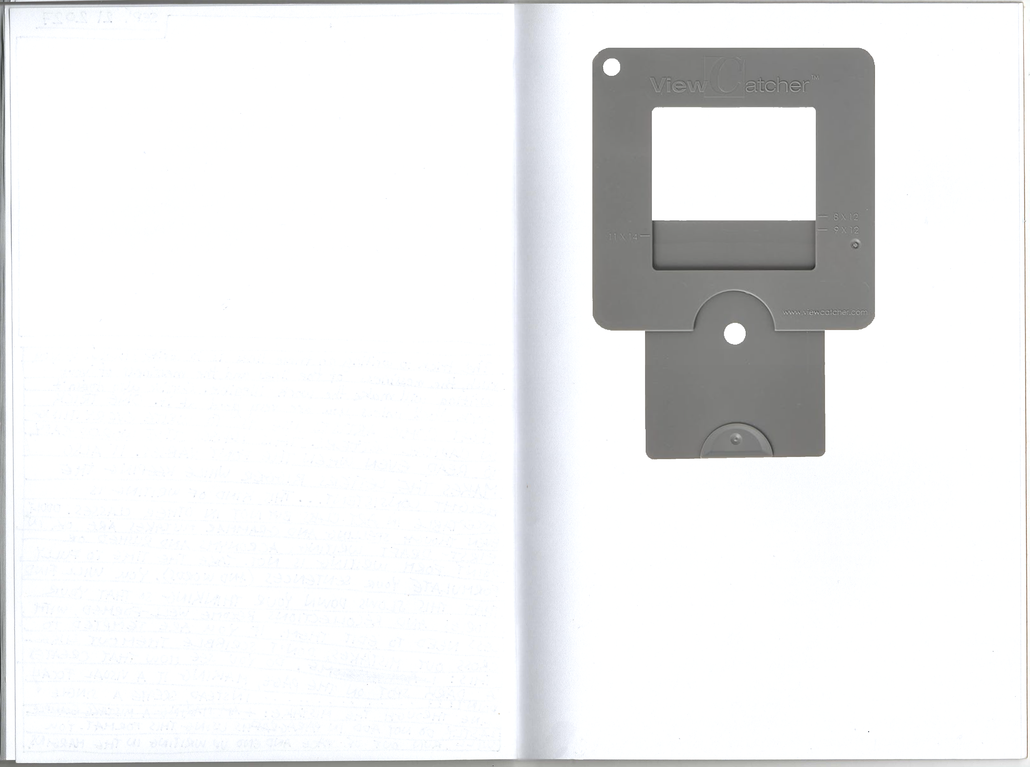
Position the viewfinder above your page.
Notes:
Landscape
Albert Pinkham Ryder American 1897–98
https://www.metmuseum.org/art/collection/search/11978

Slide 7
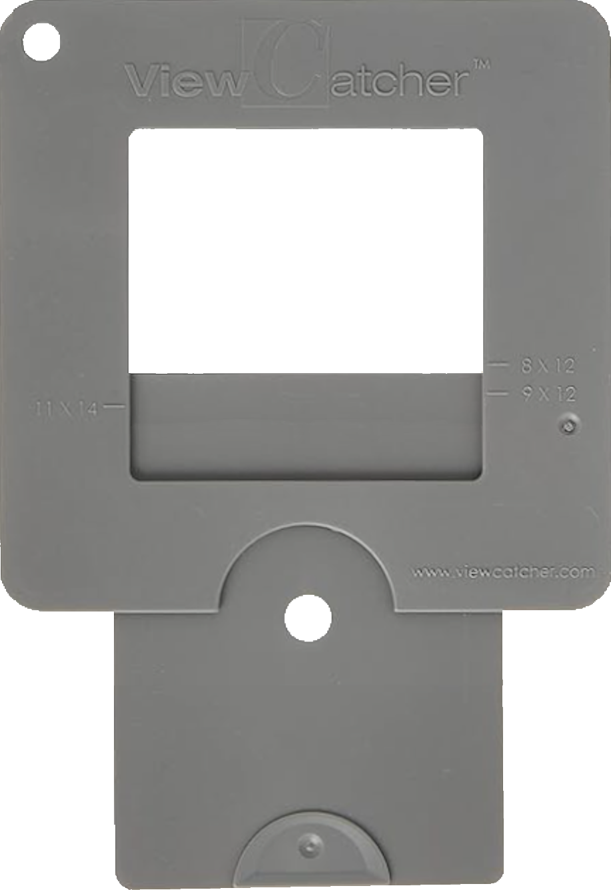
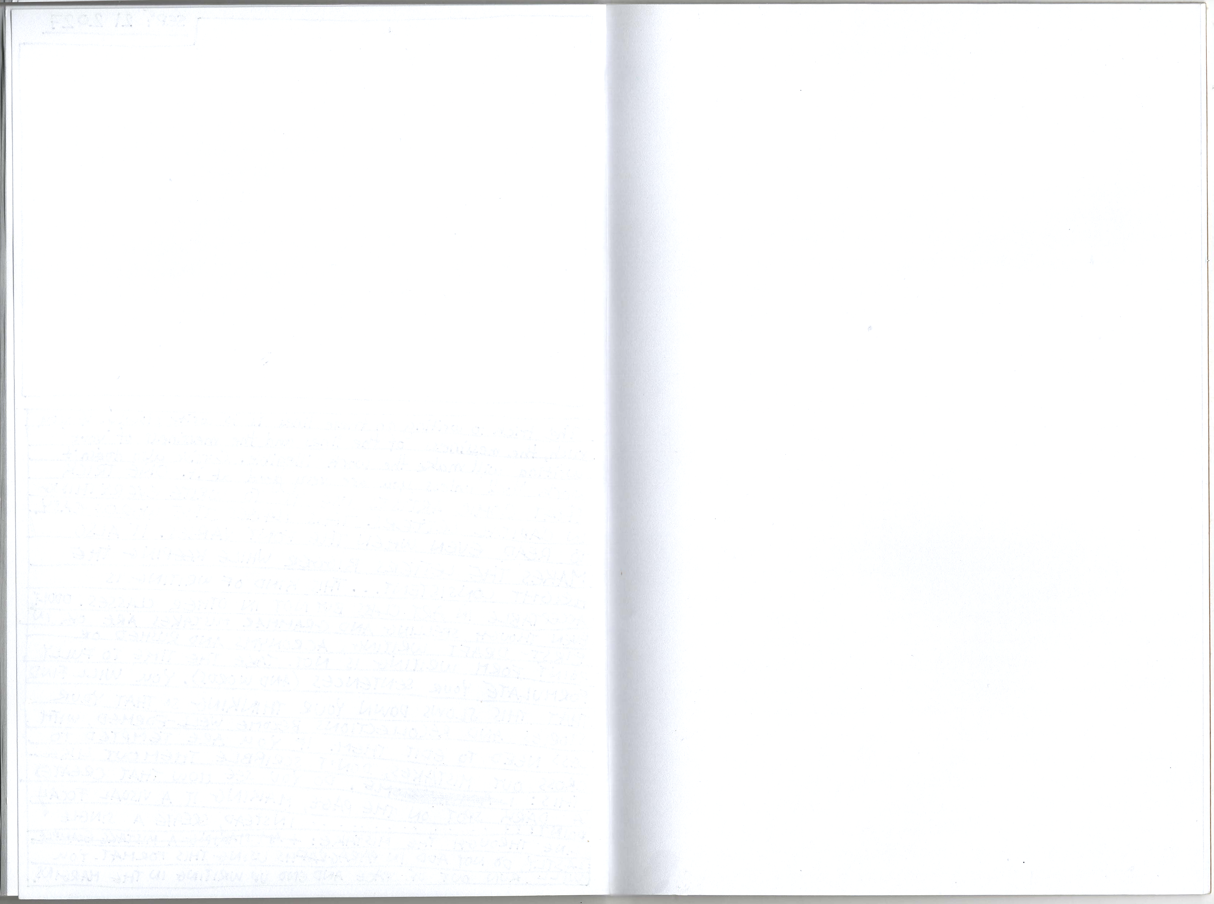
Move the viewfinder away from the page until the rectangle is the desired size.
Notes:
Landscape
Albert Pinkham Ryder American 1897–98
https://www.metmuseum.org/art/collection/search/11978

Slide 8
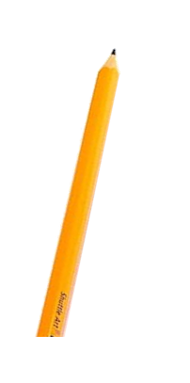

Mark the four corners of the rectangle on the page. (Hold the viewfinder steady and keep your head in the same spot.)
Notes:
Landscape
Albert Pinkham Ryder American 1897–98
https://www.metmuseum.org/art/collection/search/11978

Slide 9
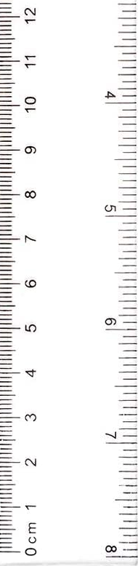

Move the viewfinder and connect the dots with a pencil and ruler.
Notes:
Landscape
Albert Pinkham Ryder American 1897–98
https://www.metmuseum.org/art/collection/search/11978

Slide 10
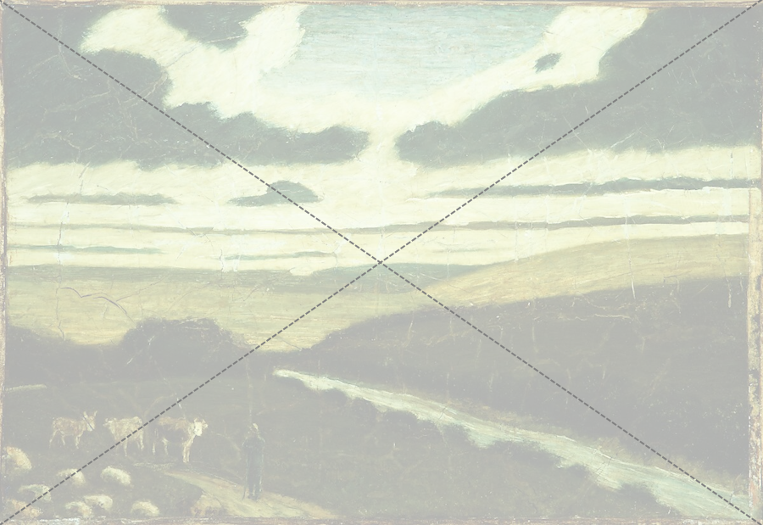
We can find the center of a piece by drawing crisscrossing lines from the top corners to the bottom corners.
Notes:
Landscape
Albert Pinkham Ryder American 1897–98
https://www.metmuseum.org/art/collection/search/11978

Slide 11

We don’t draw the whole thing.
Only lightly sketch the section where the lines intersect in the middle.
Notes:
Landscape
Albert Pinkham Ryder American 1897–98
https://www.metmuseum.org/art/collection/search/11978

Slide 12

Once we know what the center-point is, we can work out the halfway point for the four sides by adding a vertical and horizontal line.
Notes:
Landscape
Albert Pinkham Ryder American 1897–98
https://www.metmuseum.org/art/collection/search/11978

Slide 13
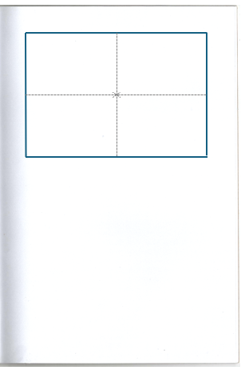
Make a Grid
Use the corner-to-corner method to find the center.
Draw a light ‘X’.
Lightly draw a vertical and horizontal line to divide your rectangle into a simple grid.
Notes:
Landscape
Albert Pinkham Ryder American 1897–98
https://www.metmuseum.org/art/collection/search/11978

Slide 14

Now that you have the proportions, draw the image.
Reminder: Credit the artist by including the title, artist’s name, place of birth, and dates.
Landscape Albert Pinkham Ryder
American 1897–98
Notes:
Landscape
Albert Pinkham Ryder American 1897–98
https://www.metmuseum.org/art/collection/search/11978

