Slide 1
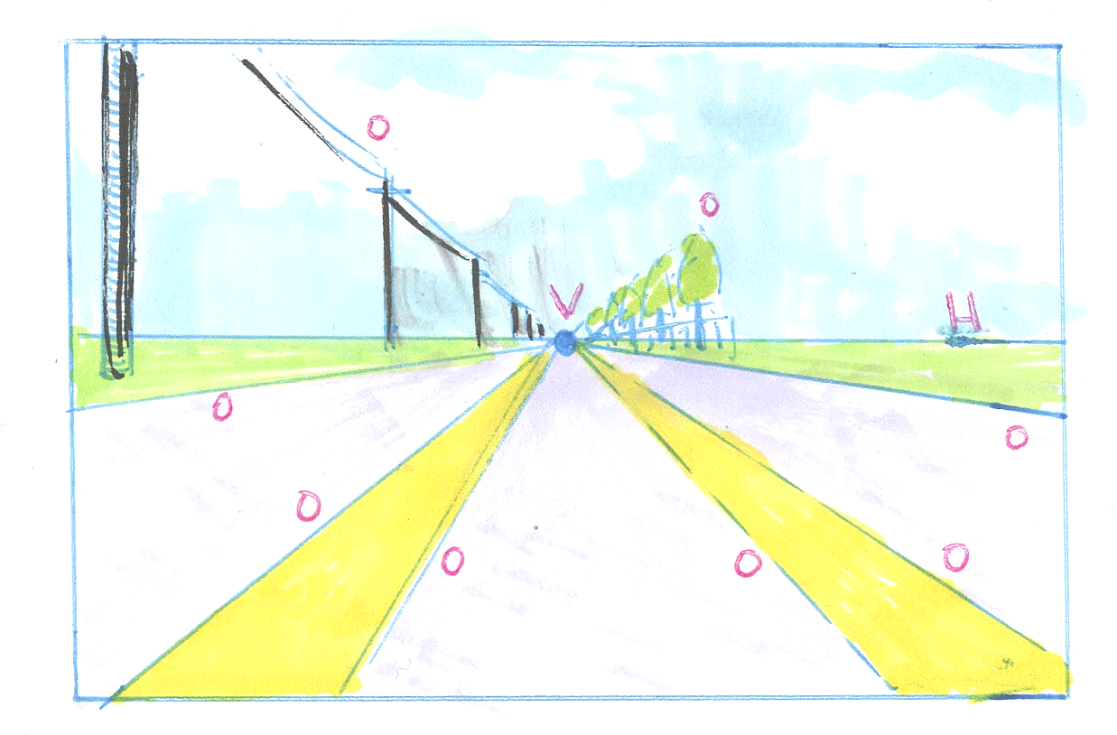
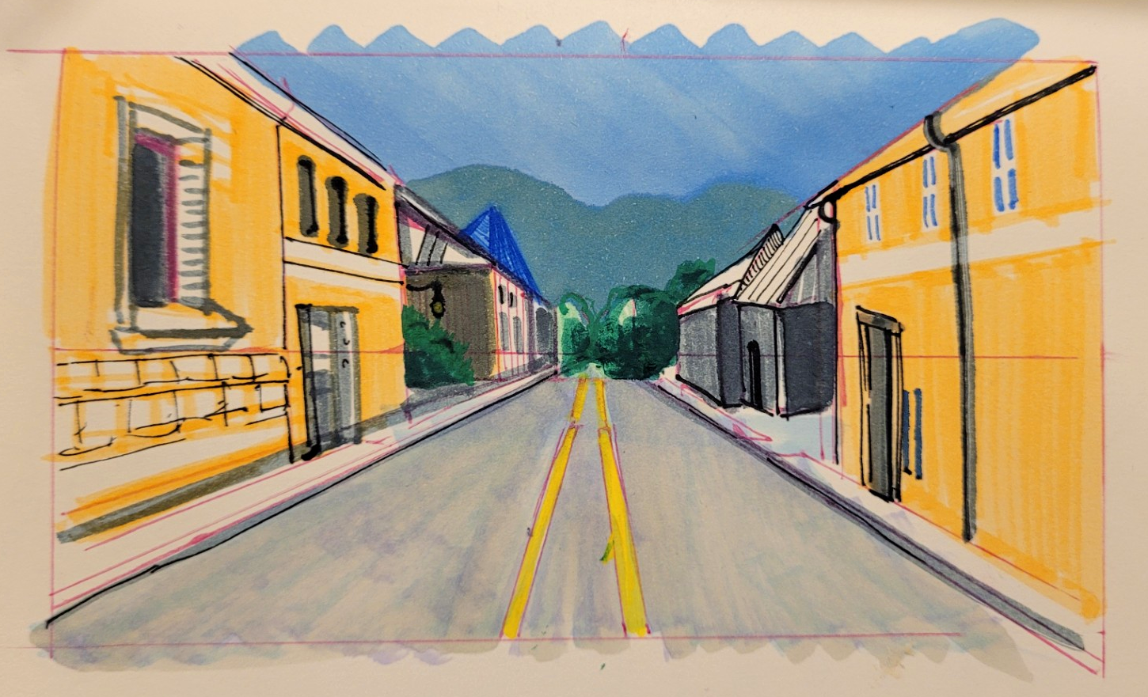
Perspective Basics
Lesson 1:
Understanding and Copying

Slide 2
Objectives
Exercises
Learn the basic terms of perspective and their functions: Horizon Line (H), Vanishing Point (V), and Orthogonal Lines.
Learn how perspective creates the illusion of dimension in drawings and photographs.
Familiarize yourself with drawing in one-point perspective using guided exercises.
Copy a one-point perspective photograph with step-by-step written and visual instructions.
Copy a one-point perspective photograph of a street using written instructions after receiving visual instructions.
Choose between images and copy your favourite with written instructions only.
Try a challenge drawing with written instructions but no image to copy.

Slide 3

One-Point Perspective, Basic Terms
DON’T COPY
Horizon Line:
The Horizon Line (H) is the shared view level of the artist and the audience.

Slide 4
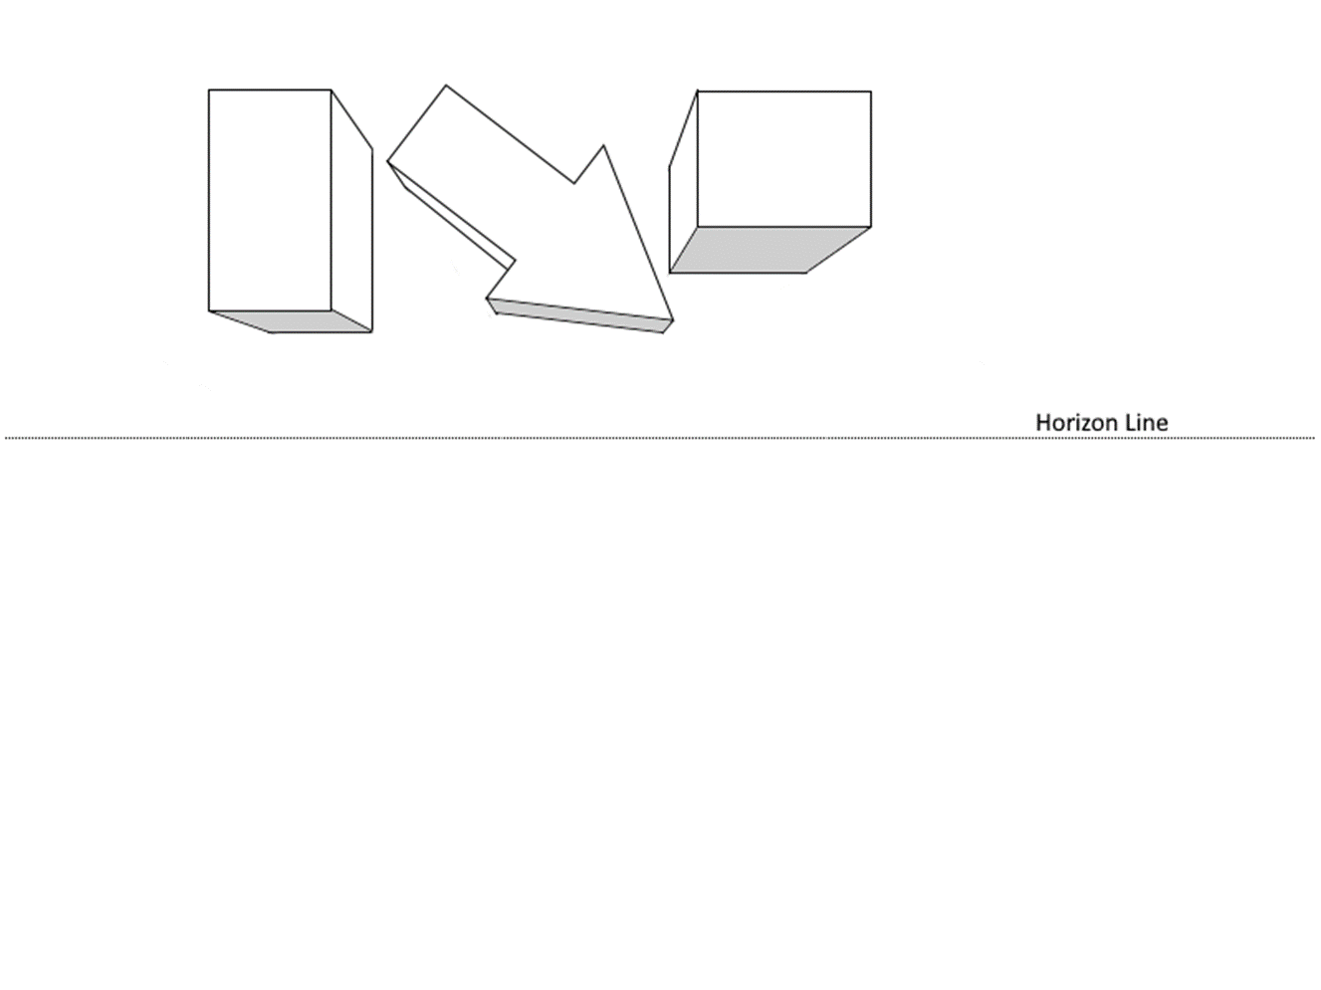
One-Point Perspective, Basic Terms
DON’T COPY
Horizon Line:
If an object is above H, we can see the bottom of the object.

Slide 5
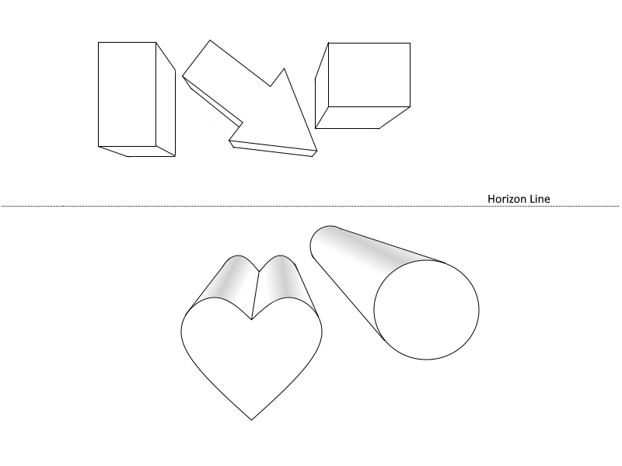
One-Point Perspective, Basic Terms
DON’T COPY
Horizon Line:
If an object is below H, we can see the top of the object.

Slide 6
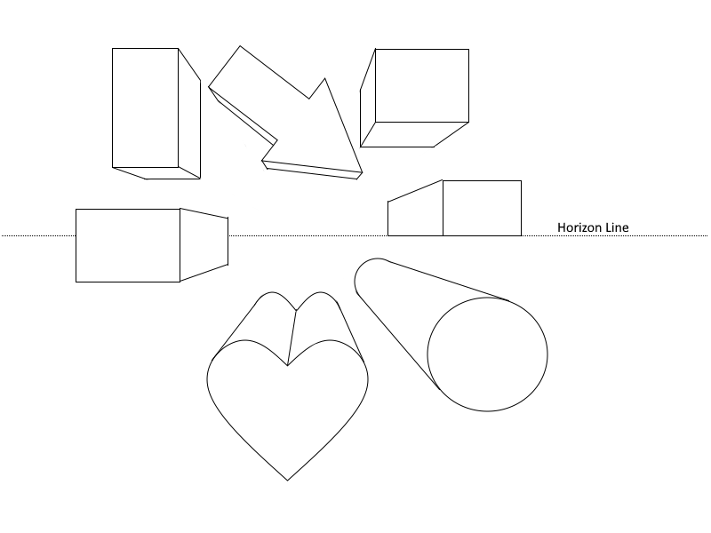
One-Point Perspective, Basic Terms
DON’T COPY
Horizon Line:
If an object is on H, we can not see the top or the bottom of the object.

Slide 7
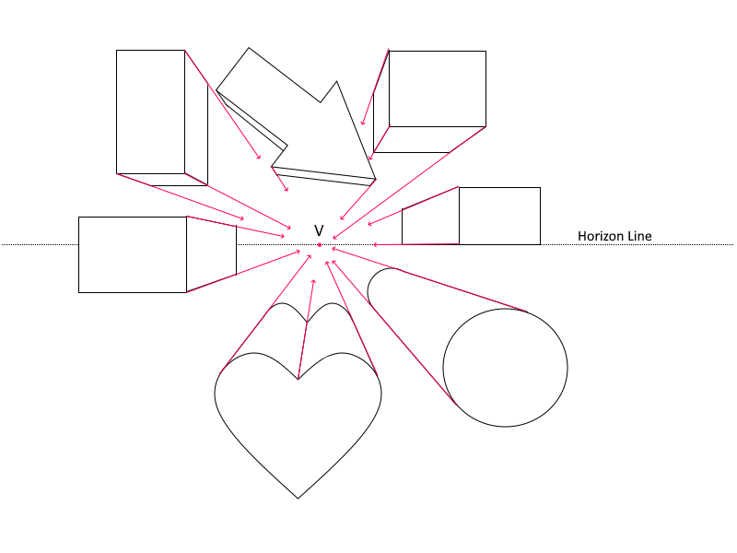
One-Point Perspective, Basic Terms
DON’T COPY
Orthogonal Lines:
Orthogonal Lines are converging depth lines in a perspective drawing. In a one-point perspective drawing, they all move toward a single Vanishing Point.

Slide 8

One-Point Perspective, Basic Terms
DON’T COPY
Vanishing Point: The Vanishing Point (V or VP) is the point on the horizon line where orthogonal lines recede into the distance.
In simpler terms, it is the target of our depth lines.

Slide 9

One-Point Perspective, Basic Terms
DON’T COPY
Let’s look at a photograph to see how this works in real life.
Source
https://pixabay.com/photos/road-pavement-road-marking-166543/

Slide 10

One-Point Perspective, Basic Terms
DON’T COPY
Here is the Horizon Line.
In landscapes, the horizon line is literally the place where land and sky meet.
A Horizon Line (H) is always the shared eye level of the artist and the audience.

Slide 11
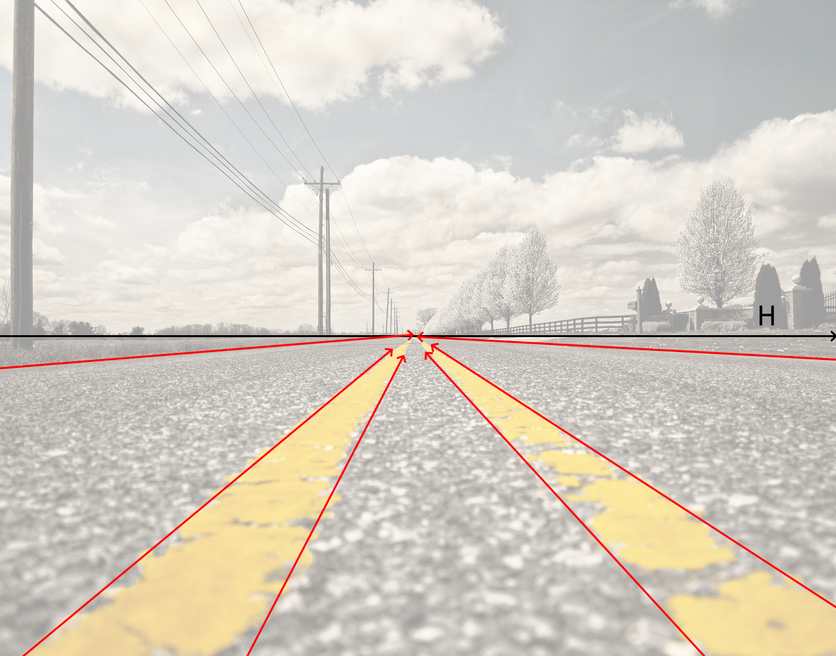
One-Point Perspective, Basic Terms
DON’T COPY
Orthogonal Lines are converging depth lines in a perspective drawing.
If you were to walk down this road, the left and right side of the road would not get narrower. These lines are parallel to each other. They give the illusion of converge toward a single Vanishing Point.

Slide 12

One-Point Perspective, Basic Terms
DON’T COPY
Vanishing Point:
The Orthogonal lines are all converging to V, a point on the horizon line.

Slide 13
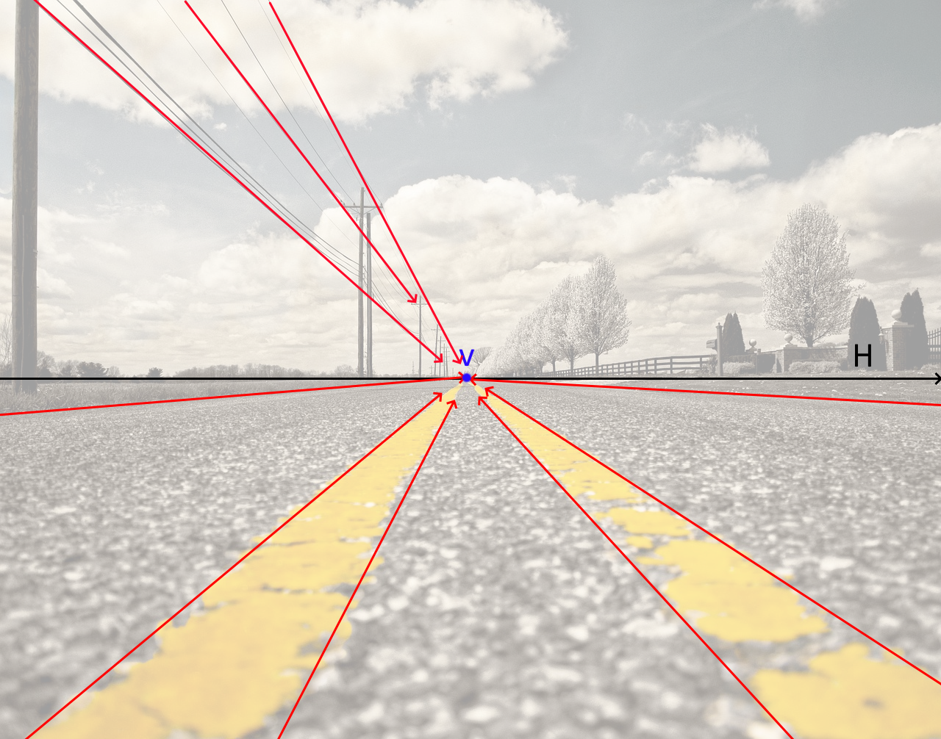
One-Point Perspective, Basic Terms
DON’T COPY
There are other, more subtle orthogonal lines in the picture. The tops of the telephone poles line up on an orthogonal line. The wires of the telephone pole are also all converging toward the vanishing point.

Slide 14

One-Point Perspective, Basic Terms
DON’T COPY
Lines of the fence are all converging toward the vanishing point.

Slide 15

One-Point Perspective, Basic Terms
DON’T COPY
Vanishing Point:
The tops of trees are converging toward the vanishing point.
This is possible because the trees are all the same age and type. They are planted in a row with regular spacing.

Slide 16

Exercise 1: Draw and Label
DON’T COPY
You will Need:
A paper
A ruler
A pencil
An eraser.
Colouring tools (optional).

Slide 17


Exercise 1: Draw and Label
TRY IT!
You will Need: A paper, a ruler, a pencil, and an eraser.
1
2
STEPS:
Recreate the approximate frame of this picture.
Add a Horizon Line.

Slide 18
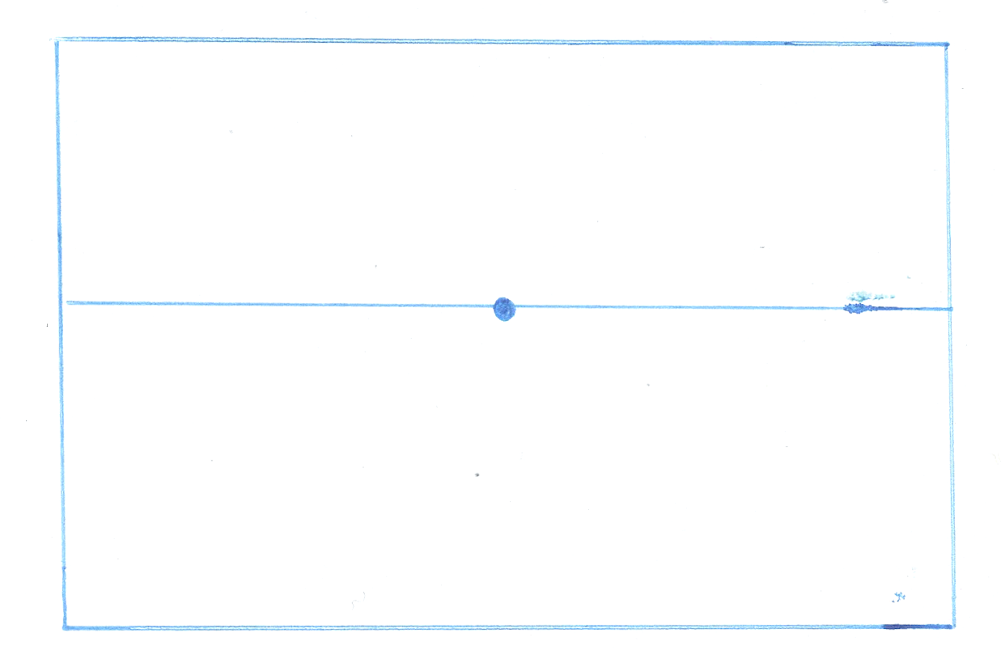
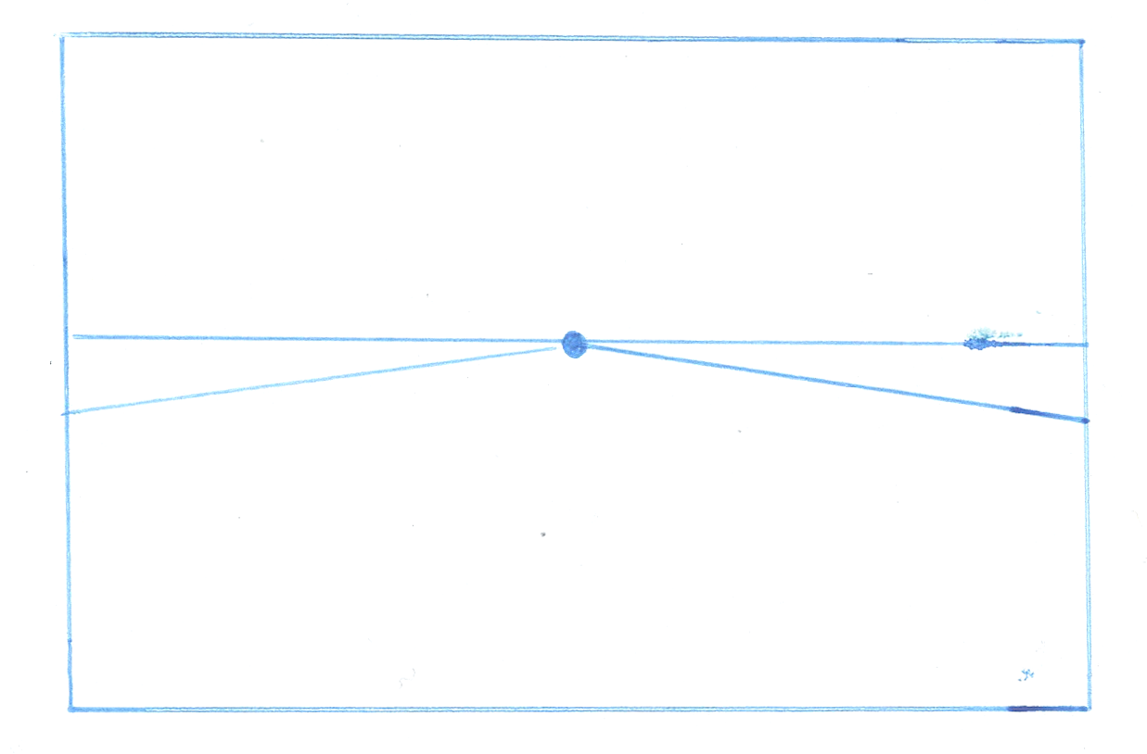
Exercise 1: Draw and Label
TRY IT!
You will Need: A paper, a ruler, a pencil, and an eraser.
3
4
STEPS:
Recreate the frame of this picture.
Add a Horizon Line
Add a Vanishing Point. This one is close to the center of the image.
Create the sides of the road using Orthogonal Lines.

Slide 19
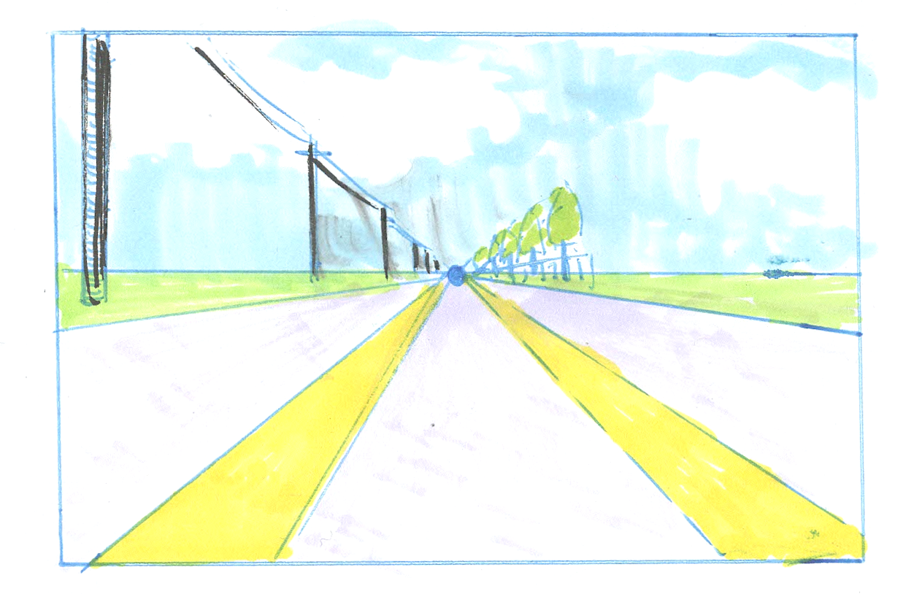
Exercise 1: Draw and Label
TRY IT!
You will Need: A paper, a ruler, a pencil, and an eraser.
5
6
STEPS:
Recreate the frame of this picture.
Add a Horizon Line
Add a Vanishing Point.
Create the sides of the road using Orthogonal Lines.
Add at least two details: the yellow road lines, the row of trees, the telephone poles and wires. Colour (optional).
Label H for Horizon Line, V for Vanishing Point, and O for Orthogonal Lines.

Slide 20
Exercise 1: Draw and Label
COPY TERMS!
You will Need: A paper, a ruler, a pencil, and an eraser.
Under, or near your diagram, write out definitions for Horizon Line, Vanishing Point, and Orthogonal Lines.
The Horizon Line (H) is the shared view line of the artist and the viewer. It is the eye level.
A Vanishing Point (V) is a point on the horizon where orthogonal lines appear to meet.
Orthogonal Lines: Illusionary parallel lines which converge at the vanishing point.

Slide 21
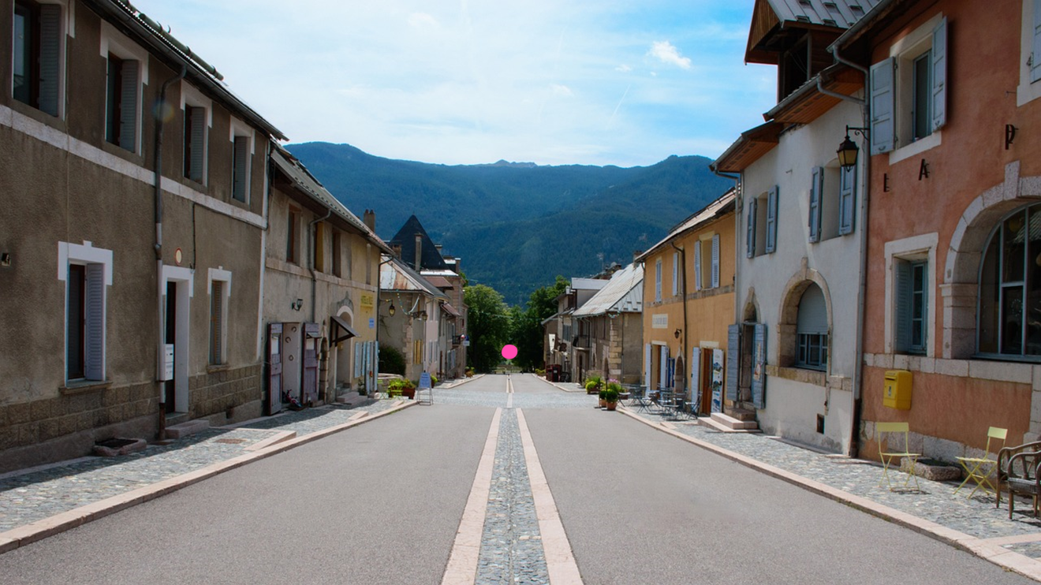
Challenges
DON’T COPY
Here is a photograph and a quick drawing.
Even though there are lots of mistakes, simplifications, and alterations, the viewer still gets some of feel of the original.
Don’t worry about getting the following challenge exercises perfect. Use them to try to work out how to make perspective work for you.

Slide 22

Challenge 1: Draw with a Vanishing Point
DON’T COPY YET
PREP:
LOOK
In our first challenge, we will make a version of this picture. Don’t start drawing yet. The next few slides will should you how to find the important lines in this image.
https://pixabay.com/photos/road-houses-city-village-old-town-6881040/

Slide 23

Challenge 1: Draw with a Vanishing Point
DON’T COPY YET
PREP:
LOOK
There are lots of parallel lines in this photo. The divisions between buildings, the vertical sides of windows and doors are parallel to each other. They are simply vertical lines and there are dozens of them hidden in the picture.
https://pixabay.com/photos/road-houses-city-village-old-town-6881040/

Slide 24
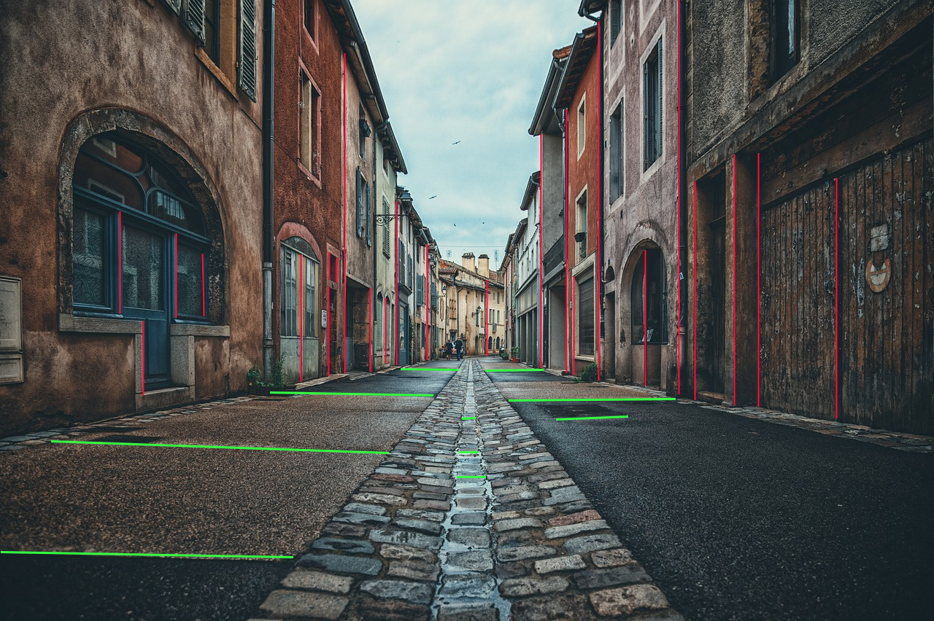
Challenge 1: Draw with a Vanishing Point
DON’T COPY YET
PREP:
LOOK
There are also many parallel horizontal lines. The sewer grate and the lines of the paving stones are a little sloped, but many are horizontal as well. This is often the case with architectural features, which are built on the idea of boxes, which fit together neatly. As nature takes over, they become more organic and less squared off.
https://pixabay.com/photos/road-houses-city-village-old-town-6881040/

Slide 25

Challenge 1: Draw with a Vanishing Point
DON’T COPY YET
PREP:
LOOK
The bottom of this building is recognizable as an orthogonal line, running toward an imaginary vanishing point. But the line does not continue unbroken. The other buildings have subtly different placement. They are not perfectly parallel.
https://pixabay.com/photos/road-houses-city-village-old-town-6881040/

Slide 26

Challenge 1: Draw with a Vanishing Point
DON’T COPY YET
PREP:
LOOK
Here, we see the visible bottom of each building as its own line.
https://pixabay.com/photos/road-houses-city-village-old-town-6881040/

Slide 27

Challenge 1: Draw with a Vanishing Point
DON’T COPY YET
PREP:
LOOK
We can use the closest line and extend it. Notice that the other lines look to be pointing at approximately the same spot.
https://pixabay.com/photos/road-houses-city-village-old-town-6881040/

Slide 28
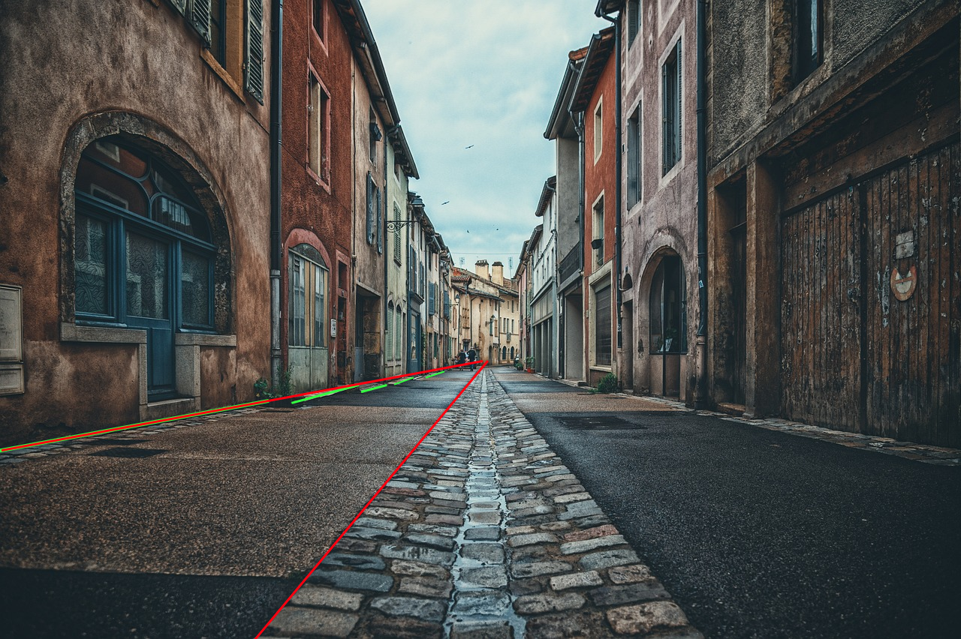
Challenge 1: Draw with a Vanishing Point
DON’T COPY YET
PREP:
LOOK
Here’s a solid orthogonal line on the street itself…
https://pixabay.com/photos/road-houses-city-village-old-town-6881040/

Slide 29

Challenge 1: Draw with a Vanishing Point
DON’T COPY YET
PREP:
LOOK
… and another, pointing to the same approximate location.
https://pixabay.com/photos/road-houses-city-village-old-town-6881040/

Slide 30
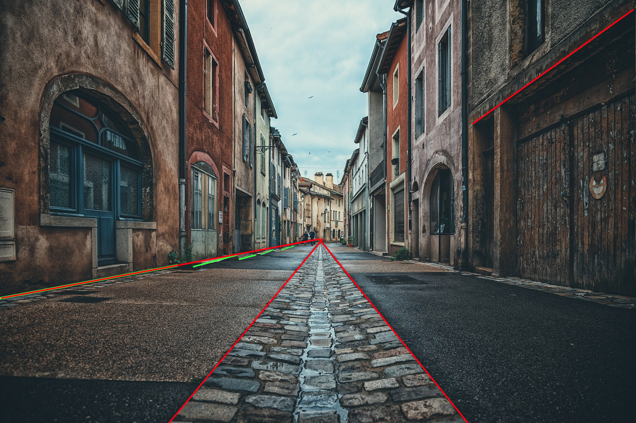
Challenge 1: Draw with a Vanishing Point
DON’T COPY YET
PREP:
LOOK
On the top right, we can see an orthogonal line above a door and window. We can extend it and…
https://pixabay.com/photos/road-houses-city-village-old-town-6881040/

Slide 31
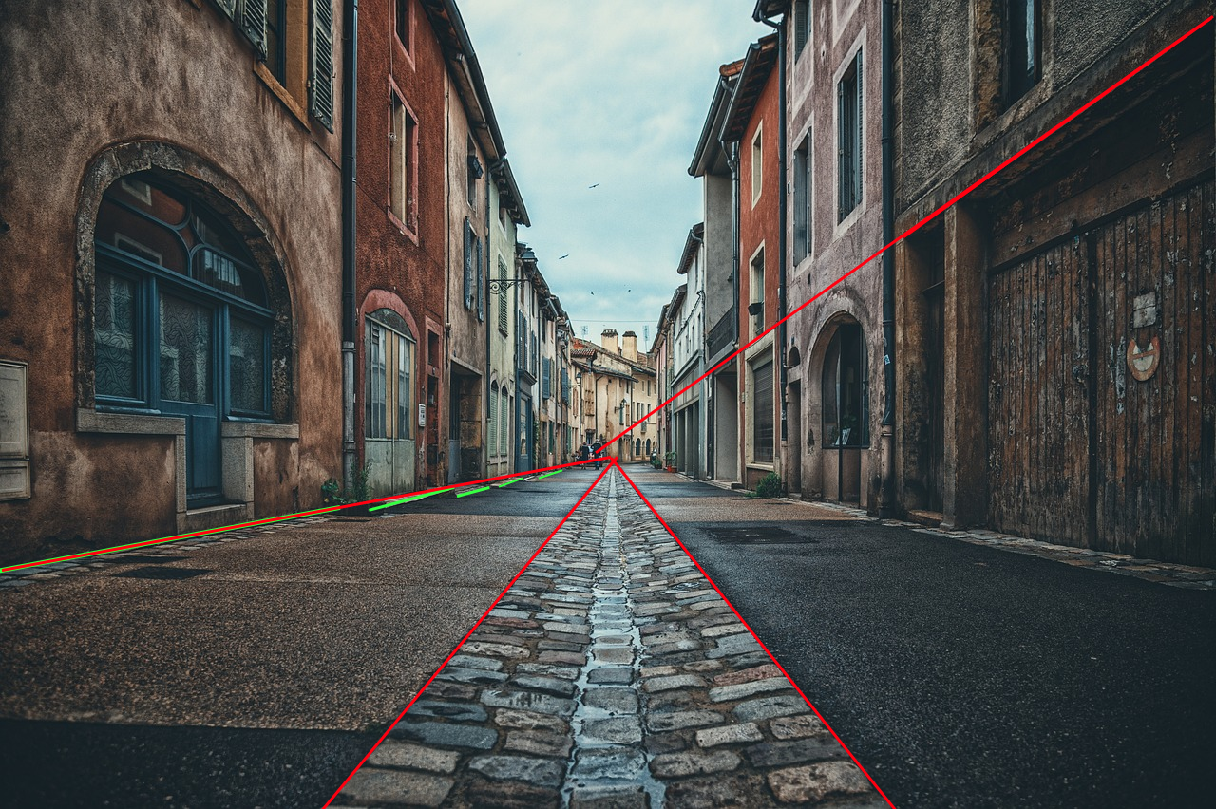
Challenge 1: Draw with a Vanishing Point
DON’T COPY YET
PREP:
LOOK
… it is very close to the spot where our established lines seem to meet.
Why isn’t it touching? Because these lines are almost but not quite parallel in real life. The ground is not quite even. The street is on a slight slope.
https://pixabay.com/photos/road-houses-city-village-old-town-6881040/

Slide 32
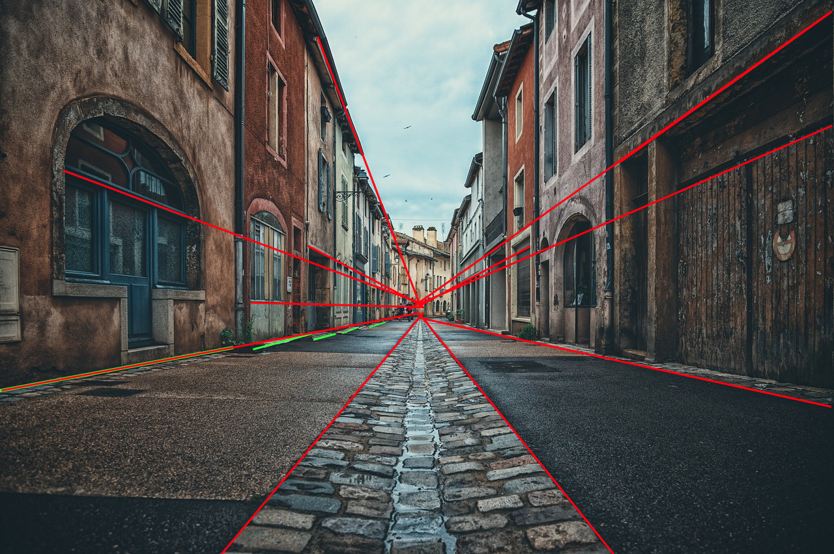
Challenge 1: Draw with a Vanishing Point
DON’T COPY YET
PREP:
LOOK
Here are a few more orthogonal lines.
In a moment, you will draw a simplified version of this image. Give it one, clear vanishing point (V). Use V to create the orthogonal lines. This will give you the approximate placement for important features.
https://pixabay.com/photos/road-houses-city-village-old-town-6881040/

Slide 33

Challenge 1: Draw with a Vanishing Point
TRY IT!
You will Need: A paper, a ruler, a pencil, and an eraser.
STEPS:
Recreate the frame of this picture. Notice that it is wider than it is tall.
Add a Vanishing Point (estimate).
Create the sides of the road using Orthogonal Lines.
Add many details: the central road lines, the sidewalks, the building tops and bottoms, some doors and windows.
Colour (optional).
https://pixabay.com/photos/road-houses-city-village-old-town-6881040/

Slide 34
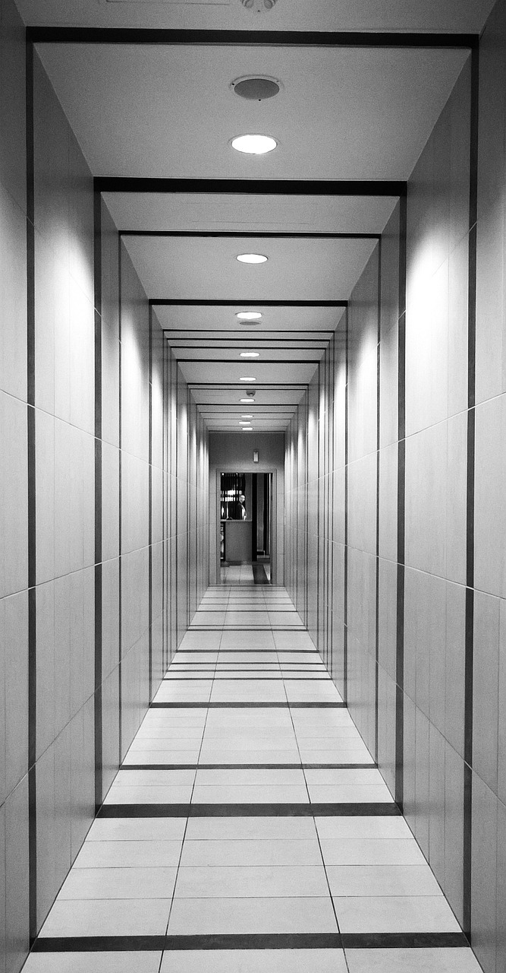
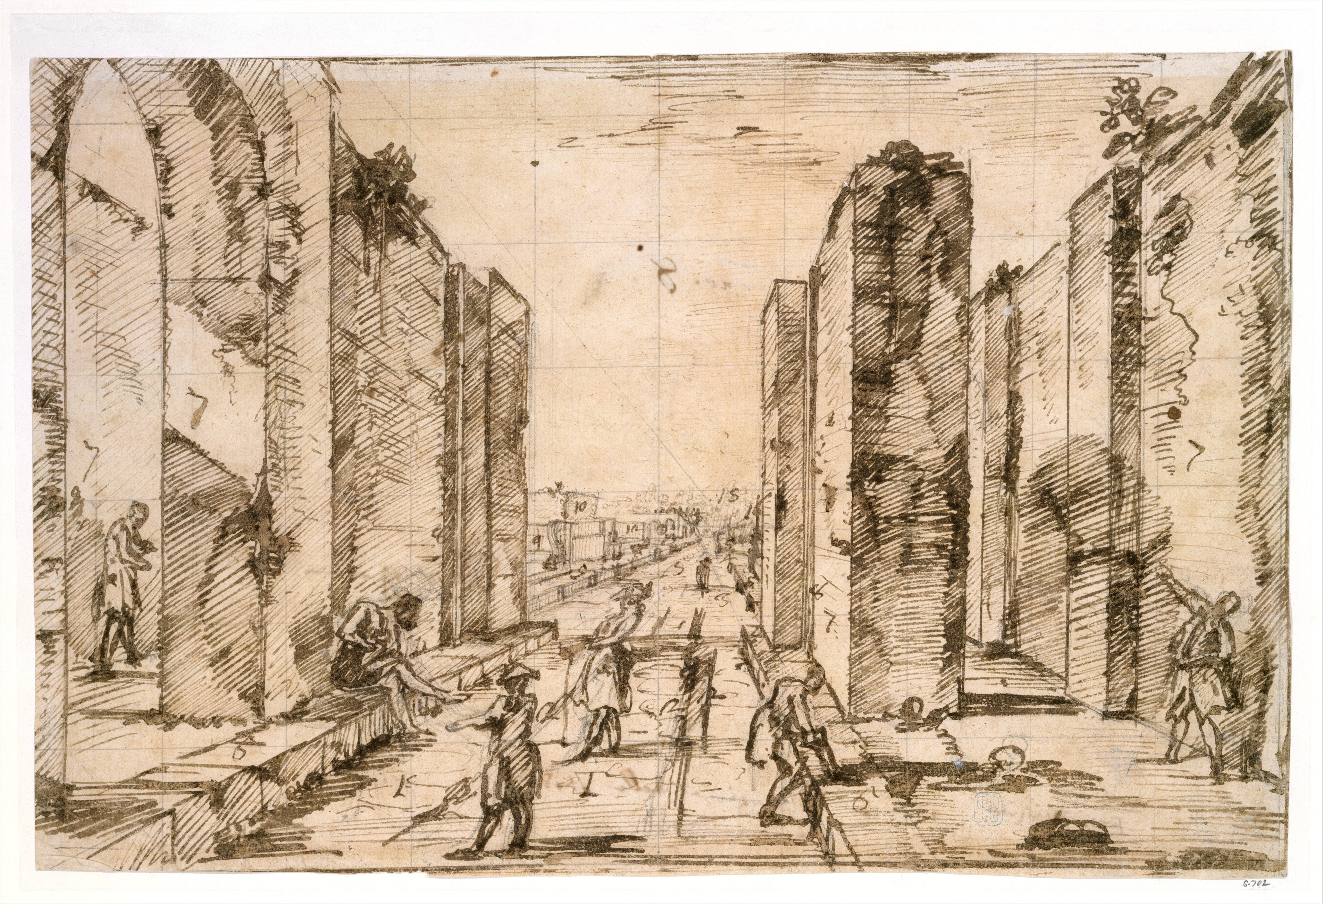
Challenge 2: Find the Vanishing Point and then Draw
TRY IT!
You will Need: A paper, a ruler, a pencil, and an eraser.
(Hint: the orthogonal lines stop before a Vanishing Point. You can continue tracing where they would meet to find the V.)
STEPS:
Select ONE image and recreate the frame.
Find where the orthogonal lines meet. Add a Vanishing point to that spot.
Add several orthogonal lines to your image.
Add detail to the image so it resembles the original.
Copy caption under your drawing.
View through the Herculaneum Gate, Pompeii, Drawing, Giovanni Battista Piranesi Italian, 1778
Hallway, Perspective, Tunnel, photograph Pixabay artist: tookapic

Slide 35
Challenge 3: Create an image that begins with a road
TRY IT!
You will Need: A paper, a ruler, a pencil, and an eraser.
STEPS:
Create the frame.
Add a Vanishing Point.
Add a Horizon Line (optional).
Use orthogonal lines to create a road.
Use more orthogonal lines to create markings on the road.
Add at least three features from the following list: buildings, a sidewalk, doors, windows, a row of trees, a row of telephone posts with wires, a fence.
Add a sky to your image.
Colour (optional)
Caption your image with a simple, descriptive name that reflects the scene without judgment (e.g. A Street in Town)

